Slide 1
Teaching the New Statistics
APS 2018 Workshop
Tamarah Smith Bob Calin-Jageman
Cabrini University Dominican University
All materials: https://osf.io/muy6u/
Twitter: @TheNewStats Blog: https://thenewstatistics.com
Pre-flight activities:
Download & unzip workshop files: https://tinyurl.com/newstats-zip
(Suggested) Download and install Jamovi: https://www.jamovi.org
(Optional) Download instructor pack: https://tinyurl.com/newstats-instructor
Wifi: Network = 2018 APS Convention; Password = APSCONV2018

Slide 2
Workshop Goals
Build your confidence and expertise as a New Statistics instructor
Case studies: Three common designs
Resources:
OSF Page on Teaching New Stats: https://osf.io/muy6u/:
Data sets
Software guides
Teaching tips, more
GitHub repo with all workshop materials
Private instructor pack: https://tinyurl.com/newstats-instructor
Assessment items and keys
Assignments and keys
Activities and keys
Slides and figures
More
Email Bob for 2 complete Canvas courses
Community

Slide 3
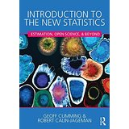
About us
Tamarah Bob (@TheNewStats)
Teach the ugrad stats and methods sequence
Moved towards New Statistics 3 years ago
Research is in Statistics Education
Incorporation of the New Statistics is a third layer in transforming stats curriculum:
Layer One: Mindset intervention
Layer Two: Gamified pedagogy
Working on assessing the ways that the new statistics positively impact student learning AND motivation
Teach in a ugrad stats/methods sequence
In 2012 we started moving towards the New Statistics
To find my way I began corresponding with Geoff Cumming
Eventually I joined Geoff in writing an undergrad stats textbook focusing on the New Statistics and Open Science
We’re not stats prodigies
Together we have 7 years of experience teaching the New Stats approach

Slide 4
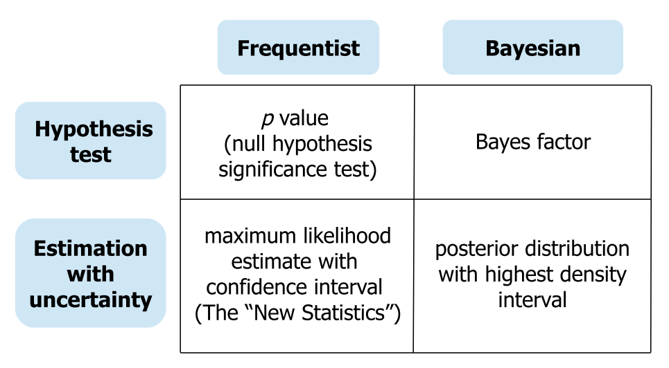
What is the New Statistics?
Effect sizes,
Confidence intervals,
Meta-analysis
Effect sizes,
Credible intervals
Bayesian meta-analysis
Adapted from Figure 1 of Kruschke & Liddell, 2017
The approach is not new, but for many fields adoption is novel.
It’s for everyone (frequentists and Bayesians)
Hypothesis testing becomes a special case of interpreting estimates
Not a ritual – requires thought/interpretation and sensitivity to research context

Slide 5
The New Statistics: 4 Guiding Principles
Ask quantitative questions and give quantitative answers (effect sizes).
Countenance uncertainty by visualizing and interpreting confidence intervals or credible intervals.
Seek replication and use meta-analysis as a matter of course.
Use Open Science practices to enhance the interpretability of research results.
There is no uncertainty that we can’t quantify.
- Emery Brown, MIT

Slide 6
What is the New Statistics?
Effect sizes,
Confidence intervals,
Meta-analysis
Effect sizes,
Credible intervals
Bayesian meta-analysis
Adapted from Figure 1 of Kruschke & Liddell, 2017
Mathematical foundations are the same, so in important ways the transition is easy
Very different way of thinking:
For those steeped in decision-making: need to break some old habits and form some new ones
For those new to statistics: easier to learn; they won’t know they have it so good

Slide 7
New Statistic fits with Good Pedagogy!
GAISE Report
Guidelines for Assessment and Instruction in Statistics Education (American Statistical Association, 2016)
Google It!
Read It!

Slide 8
GAISE Report
Teach statistical thinking.
Teach statistics as an investigative process of problem-solving and decision making.
Give students experience with multivariable thinking.
Focus on conceptual understanding.
Integrate real data with a context and purpose.
Foster active learning.
Use technology to explore concepts and analyze data.
Use assessments to improve and evaluate student learning.
Notes:
The GAISE recommendations are clear: students needs to be given less computation and more hands on experience with problem solving in context. Rather than drilling computation, help students develop real life research questions, use real data to practice analyzing data to answer that question that includes visualization. Allow student to be active and use technology to analyze data. Importantly, use assessment to determine how strategies are working and make changes when needed. In sum, the old technique of demonstrating computations on the board and having students replicate these computations is not effective. Don’t do it.

Slide 9
How Does Teaching the New Statistics meet GAISE?
Statistical thinking: problem-solving and decision making
The research questions must be reworded: not is there an effect, but how much and is this meaningful?
Focus on conceptual understanding
What is a p-value? How does it work? What is an effect size? How is it different from a p-value in terms of context (not computationally...although this can lead to a conversation about computation)
Foster active learning
Setting a research question in context and exploring it visually makes the process very active!
Use technology to explore…
Lots of great technology for the New Statistics, and we will see some today

Slide 10
The Plan
Case Studies: Three common designs
Comparing two independent means
Comparing two independent proportions
Estimating interactions
Pedagogical Considerations
Discussion

Slide 11
The difference between two means
NHST Approach: The independent samples t-test
Before starting, students should understand
Sampling error
Sampling distributions
Central limit theorem
Standard error of the mean
Margin of error of the mean
Systems of measurement (NOIR)
Basic design consideration (experimental vs. non-experimental)
Let’s re-work an example from NHST to New Stats
Will build on and
solidify these foundations

Slide 12
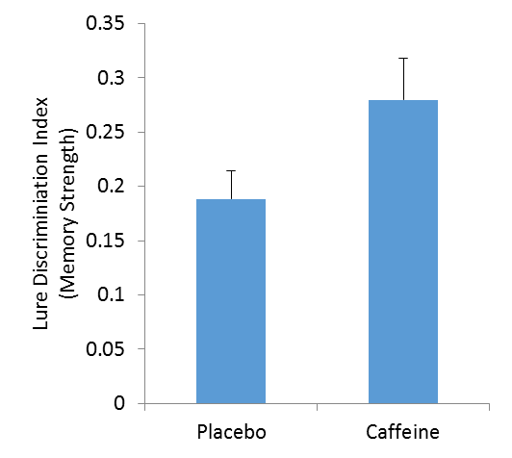
Does Caffeine Affect Memory?
Group difference was statistically significant (t(42) = 2.04, p = 0.05).
Caffeine improves memory.
Error bars are 1 SEM
Data modeled after Borota et al. (2014)

Slide 13
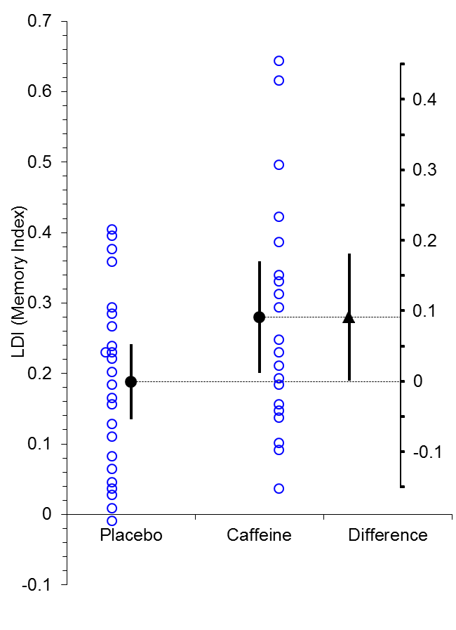
Does Caffeine Affect Memory?
How Much Does Caffeine Affect Memory?
Quantitative question with effect-size answer
CI represents uncertainty estimating pop. parameter
Caffeine benefit: M_{caffeine}-M_{placebo} = 0.09, 95% CI[0.001, 0.18]
The data are consistent with anywhere from a vanishingly small up to a very large effect. Need more data; caffeine probably doesn’t hurt memory.
Group difference was statistically significant (t(42) = 2.04, p = 0.05).
Caffeine improves memory.
Error bars are 95% CIs
Interpretation takes uncertainty seriously (whole CI)
Plot shows data, effect size, and CI
Data modeled after Borota et al. (2014)

Slide 14
The difference between two means
Student Objectives:
Understand the calculations
Effective use of software (estimation and visualization)
Thoughtful interpretation
Clear communication

Slide 15
The difference between two means
The effect-size of interest is the difference between the means:
Raw Score: M_{diff} = M₁ – M₂
Standardized Difference: d = M_{diff} / s_{p}
Uncertainty can be expressed with a confidence interval:
MoE = t_{conf}(df) * SEM
SEM = s_{p} * sqrt(1/N₁ + 1/N₂)
df = (N₁ - 1) + (N₂ – 1)
CI = [M_{diff} – MoE, M_{diff} + MoE]
Decision-Making:
t = M_{diff} / SEM
Compare to t_{conf}(df)

Slide 16
The difference between two means
To what extent is sex related to negative implicit attitudes about mathematics?
Nosek et al. (2002) asked male and female Yale undergrads to complete IAT measures of attitudes towards art and math.
The first Many Labs project conducted a simplified multi-site replication (Klein et al., 2014; https://osf.io/wx7ck/)
IAT scores are calculated:
>0 indicates more bias against math
0 indicates equal feelings between art/math
< 0 indicates more bias against art
Let’s analyze data from the SDSU lab together

Slide 17
Jamovi with EstimationStats Module
Download and install Jamovi (https://jamovi.org)
Obtain NewStats module for Jamovi:
Under “software tools\jamovi module” in workshop pack
Or download directly at: https://tinyurl.com/newstats-module
Open Jamovi
Click the + button for adding a module and choose “jamovi library”
Click “sideload” tab
Double-click the + button and navigate to the module you downloaded
Download the SDSU lab data:
https://osf.io/muy6u/files/
Or clone from github: https://github.com/rcalinjageman/New_Stats_Teaching_Resources
Or:
ESCI Part 1, “Data Two” tab (in “software tools\esci” folder)
Or EstimationStats.com
Or whatever other tool you’

Slide 18
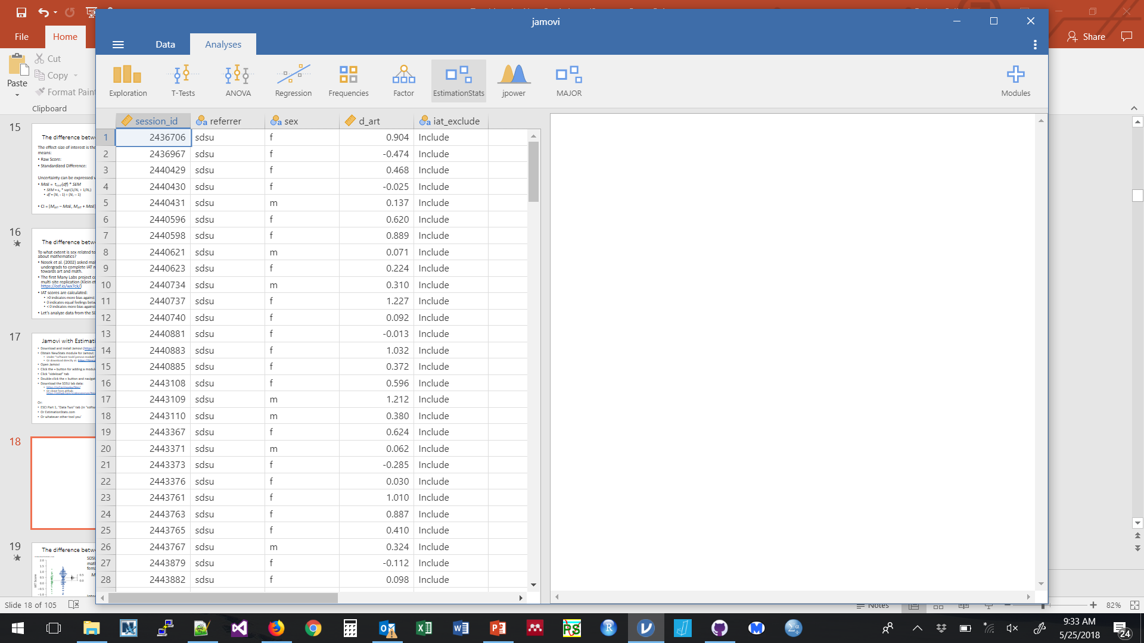
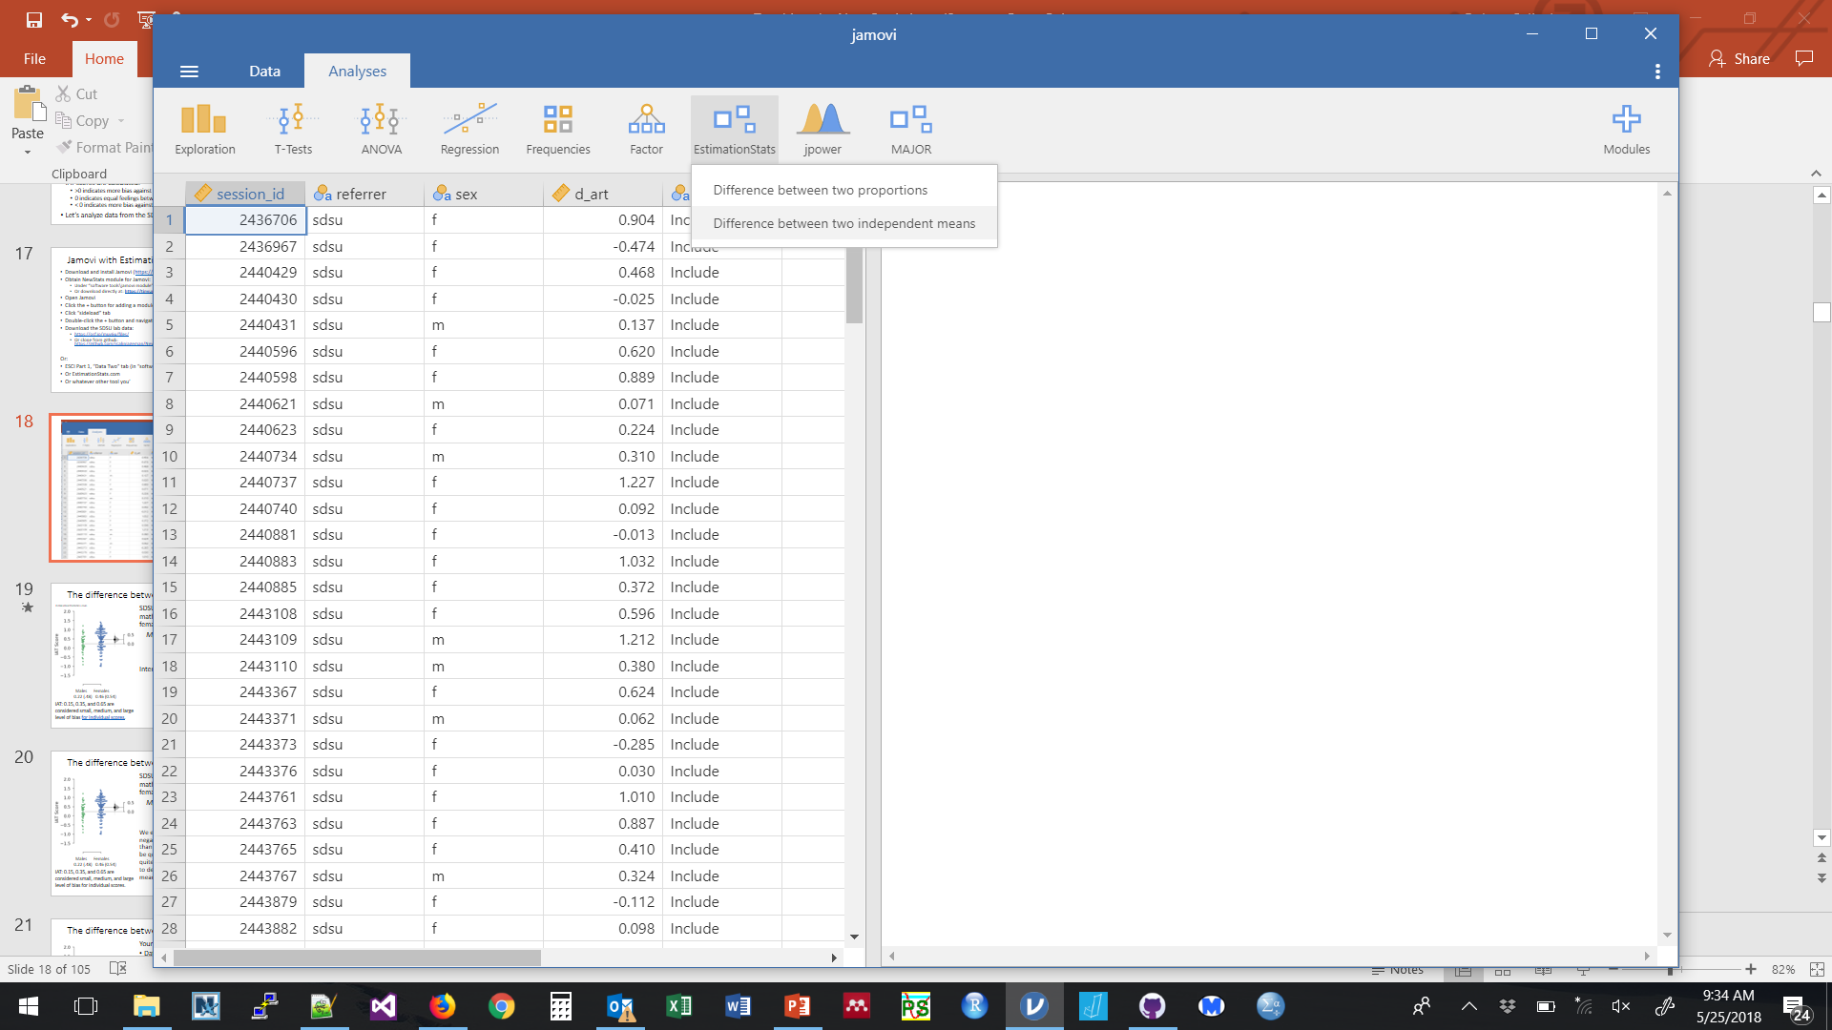
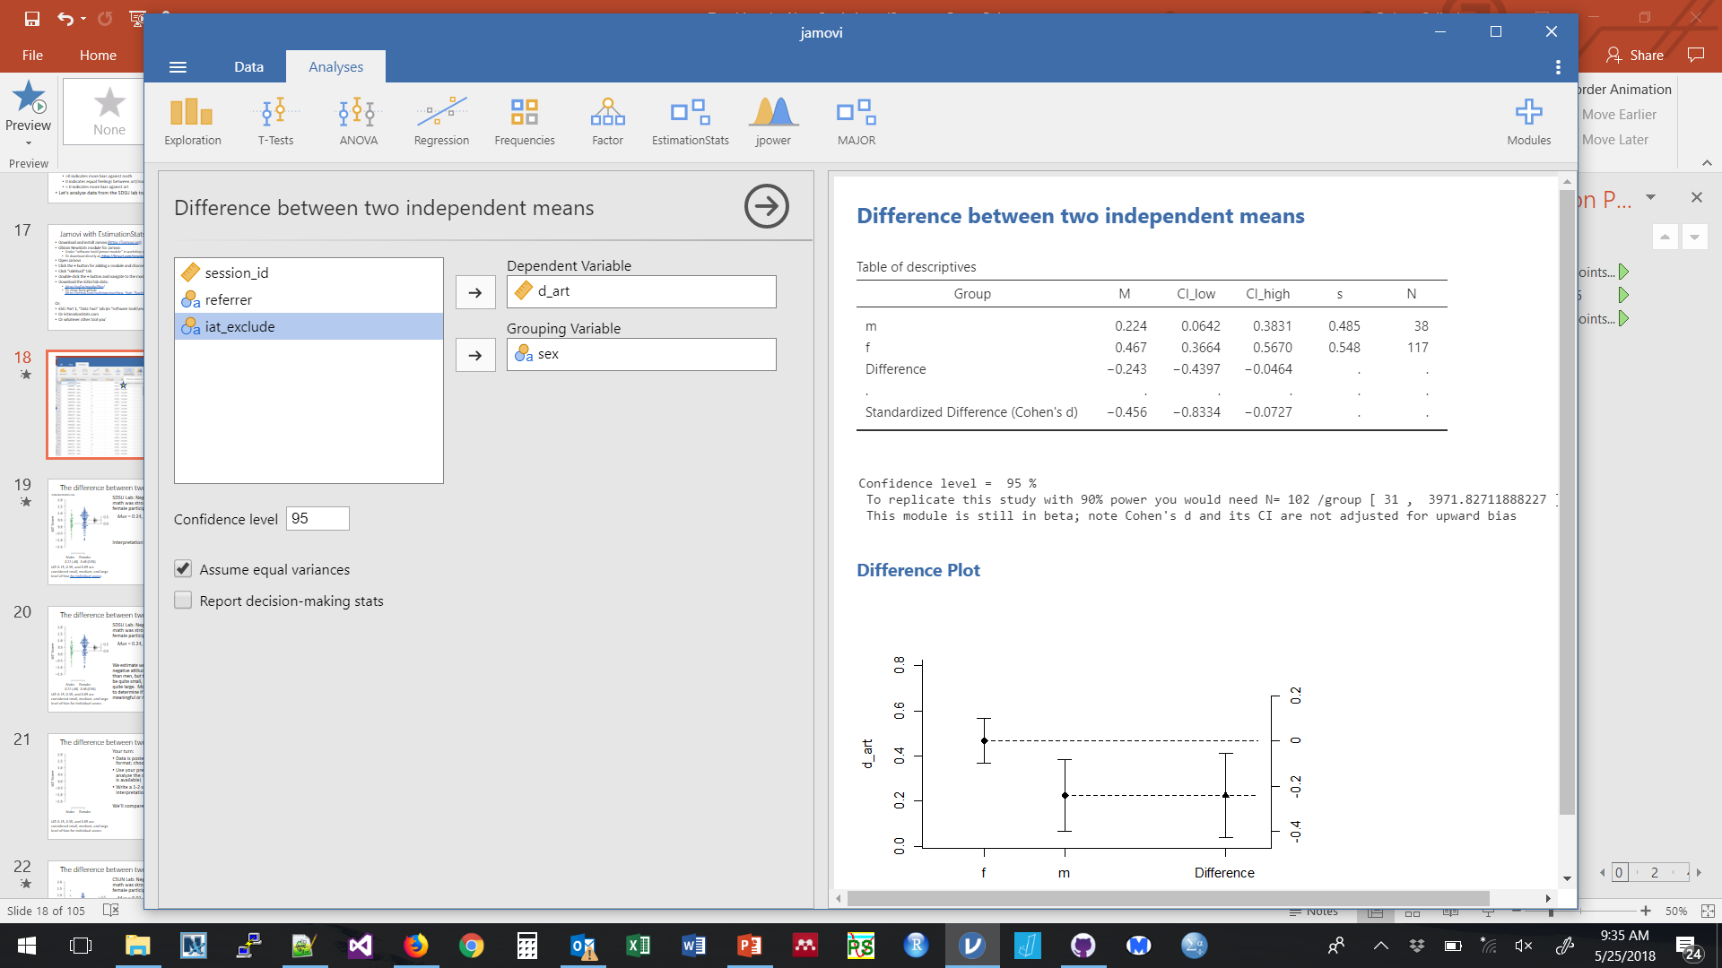
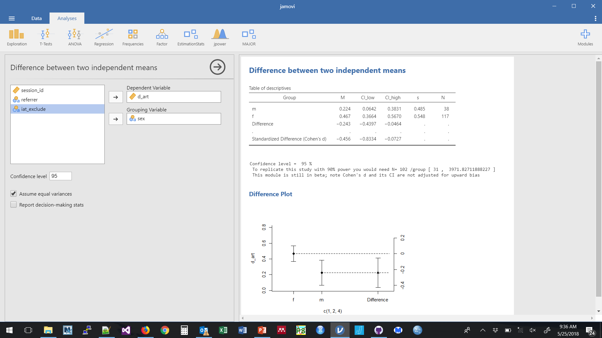

Slide 19
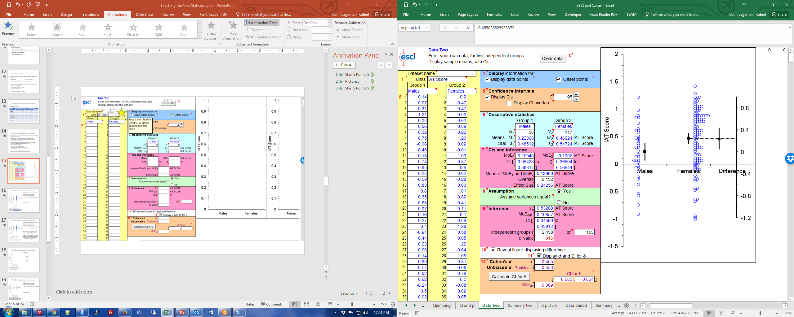
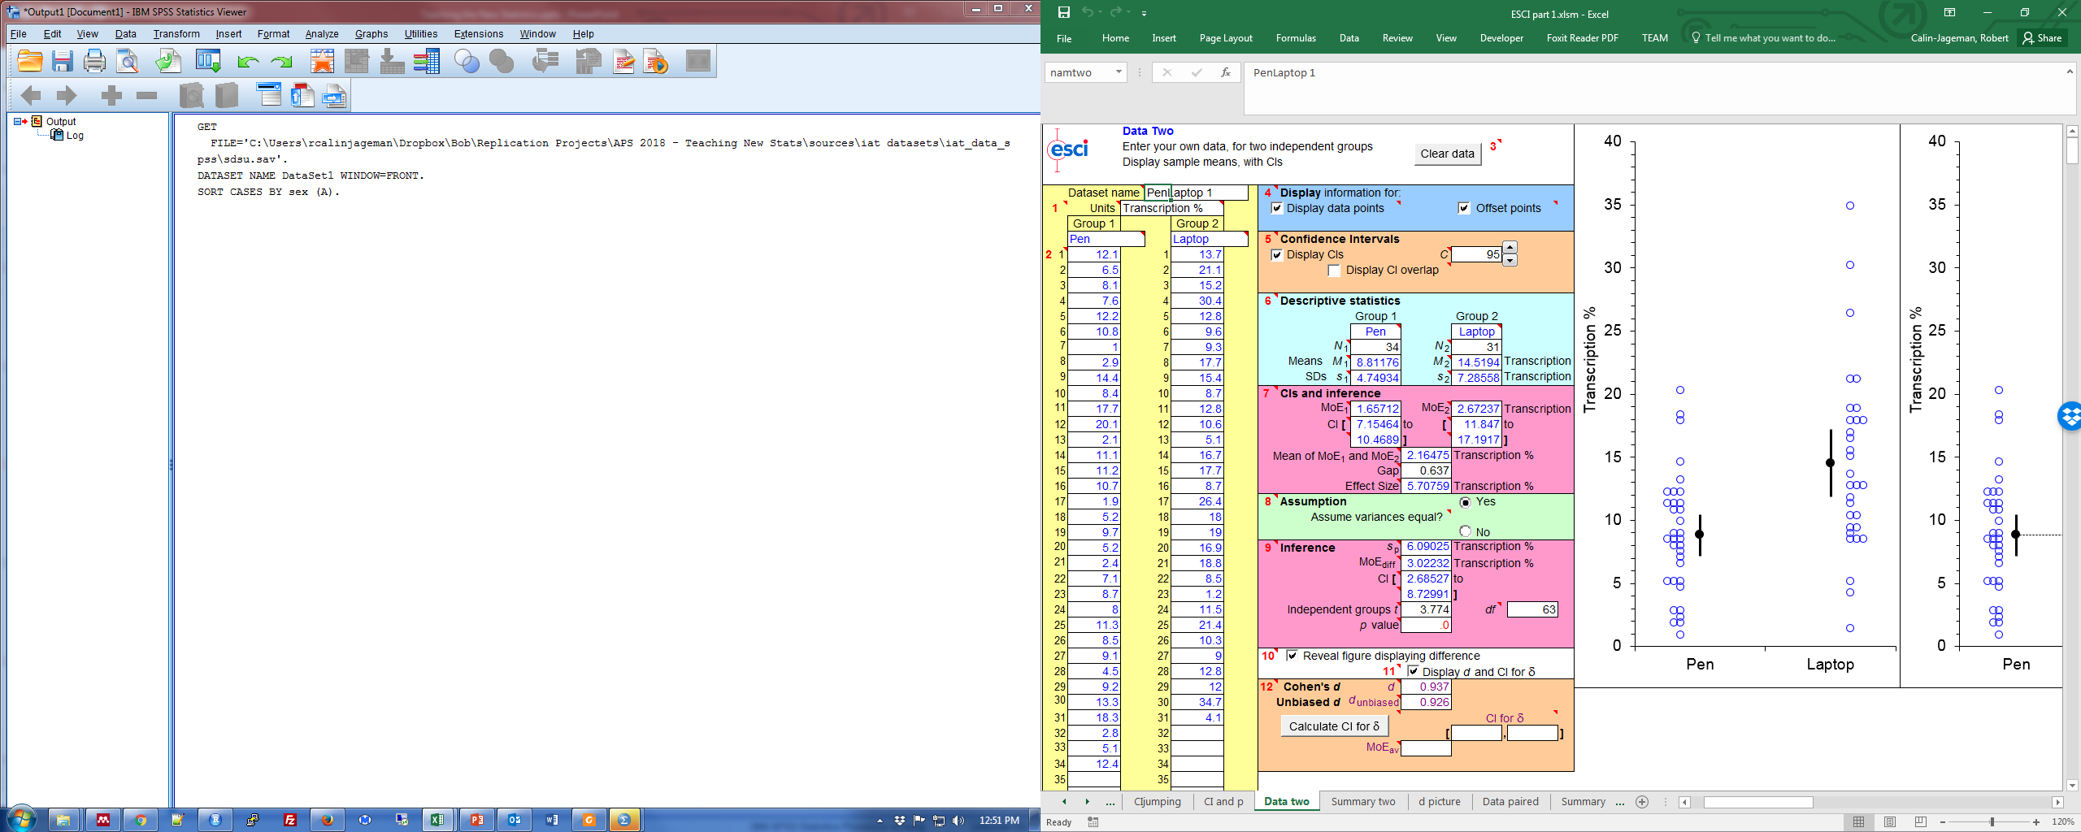
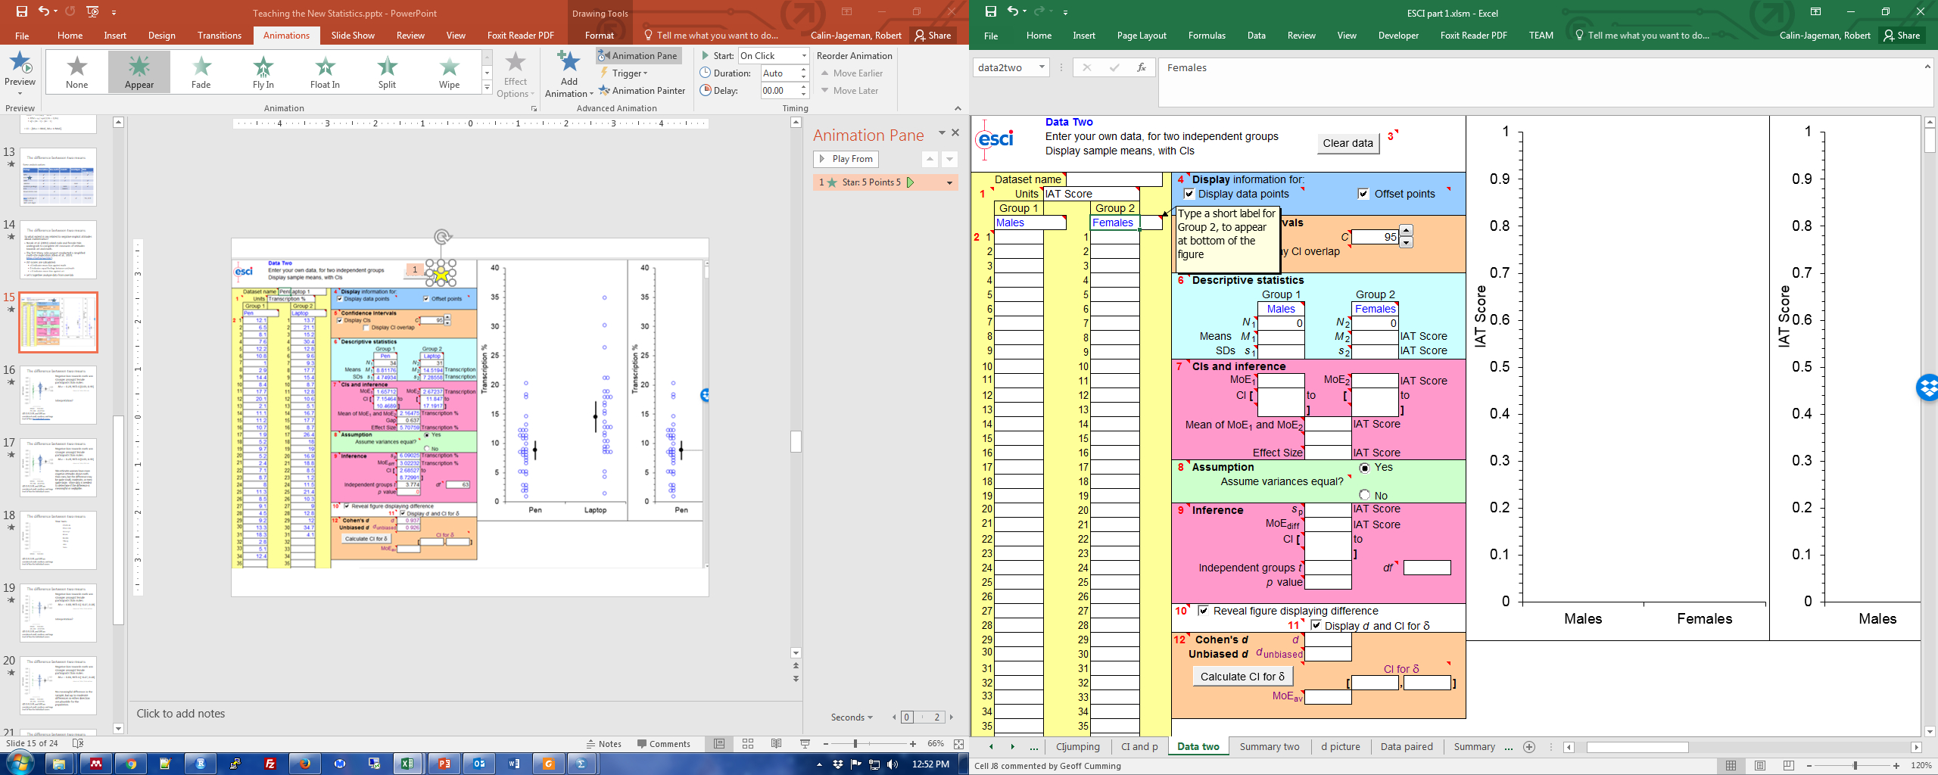
4) Check boxes at Red 10 (display diff figure and Cohen d CI)
1) ESCI Part 1, Data two tab, click “Clear Data” to remove sample data
2) Set labels for units (IAT Score) and groups (Males, Females)
3) Paste in data for males and females (paste special->values is best)
5) Click “Calculate CI for delta” button to obtain CI for Cohen’s d

Slide 20
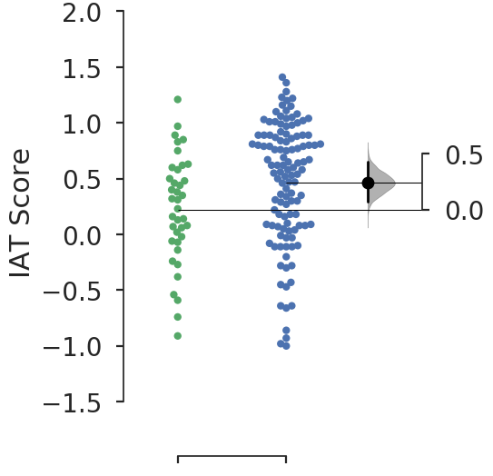
The difference between two means
EstimationStatistics.com
SDSU Lab: Negative bias towards math was stronger amongst female participants than males:
M_{diff} = 0.24, 95% CI[0.05, 0.44]
Interpretation?
Males Females
0.22 (.48) 0.46 (0.54)
IAT: 0.15, 0.35, and 0.65 are considered small, medium, and large level of bias for individual scores.

Slide 21
The difference between two means
SDSU Lab: Negative bias towards math was stronger amongst female participants than males:
M_{diff} = 0.24, 95% CI[0.05, 0.44]
We estimate women have more negative attitudes about math than men, but the difference may be quite small, moderate, or even quite large. More data is needed to determine if the difference is meaningful or negligible.
Males Females
0.22 (.48) 0.46 (0.54)
IAT: 0.15, 0.35, and 0.65 are considered small, medium, and large level of bias for individual scores.

Slide 22
The difference between two means
Your turn:
Data is posted in SPSS and CSV format; choose 1 lab to analyze
Use your preferred approach to analyze the data (a script for R is available)
Write a 1-2 sentence interpretation.
We’ll compare results
Males Females
IAT: 0.15, 0.35, and 0.65 are considered small, medium, and large level of bias for individual scores.

Slide 23
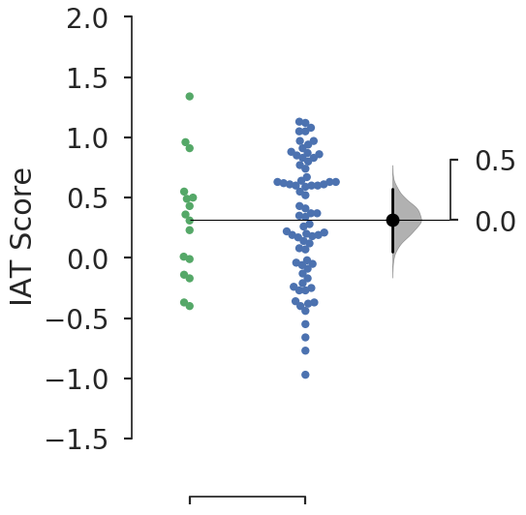
The difference between two means
CSUN Lab: Negative bias towards math was stronger amongst female participants than males:
M_{diff} = 0.01, 95% CI[-0.27, 0.28]
Interpretation?
Males Females
0.31 (.49) 0.32 (0.50)
IAT: 0.15, 0.35, and 0.65 are considered small, medium, and large level of bias for individual scores.

Slide 24
The difference between two means
CSUN Lab: Negative bias towards math was stronger amongst female participants than males:
M_{diff} = 0.01, 95% CI[-0.27, 0.28]
No meaningful difference in the sample, but up to moderate differences in either direction are plausible for the population.
Males Females
0.31 (.49) 0.32 (0.50)
IAT: 0.15, 0.35, and 0.65 are considered small, medium, and large level of bias for individual scores.

Slide 25
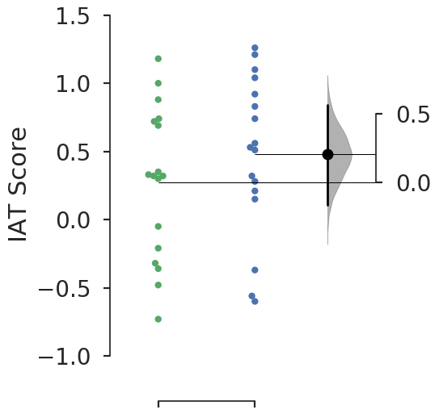
The difference between two means
Partial Ithaca Lab: Negative bias towards math was stronger amongst female participants than males:
M_{diff} = 0.20, 95% CI[-0.19, 0.60]
Interpretation?
Males Females
0.28 (.56) 0.48 (0.58)
IAT: 0.15, 0.35, and 0.65 are considered small, medium, and large level of bias for individual scores.

Slide 26
The difference between two means
Partial Ithaca Lab: Negative bias towards math was stronger amongst female participants than males:
M_{diff} = 0.20, 95% CI[-0.19, 0.60]
CI is long, reflecting considerable uncertainty about the population:
Women could have much stronger negative attitudes about math, or moderately stronger, or only very slightly
Or no sex difference
Or men could have slightly up to moderately stronger negative attitudes about math
Not enough data to draw clear conclusions.
Males Females
0.28 (.56) 0.48 (0.58)
IAT: 0.15, 0.35, and 0.65 are considered small, medium, and large level of bias for individual scores.

Slide 27
The difference between two means
Note the diversity in findings:
Sampling error is real!
Let’s put our results together
Jamovi file with summary results:
https://tinyurl.com/iat-overall
Then install the Major Meta-Analysis Module
Males Females
0.28 (.56) 0.48 (0.58)
IAT: 0.15, 0.35, and 0.65 are considered small, medium, and large level of bias for individual scores.

Slide 28
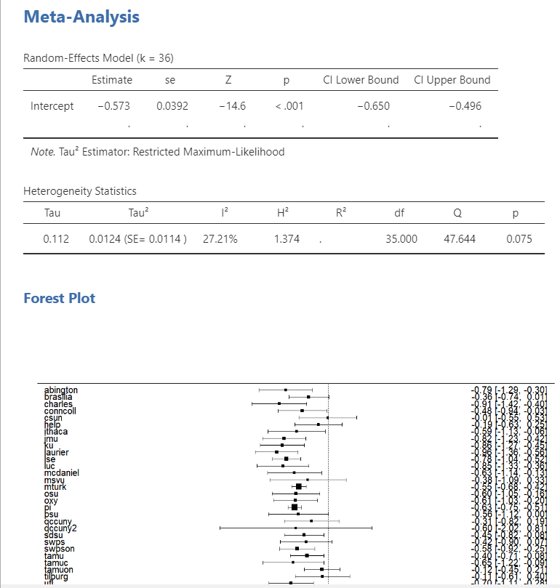
Never too early to start talking about meta-analysis
Having students analyze replication sets across the class
Authentic scientific experience
Stresses the reality of sampling error
Makes meta-analysis a natural step
Easy to do with Many Labs, RRPs, and the like
Across the ManyLabs dataset:
d = 0.57 95% CI [.50, .65]
Clear and large difference in math attitudes

Slide 29
The difference between two means
Before we move on,
How about a Bayesian approach?
SPSS 25!?
BEST (Bayesian Estimation T-Test) Krushke (2013) http://www.sumsar.net/best_online/
JASP
Males Females
0.28 (.56) 0.48 (0.58)
IAT: 0.15, 0.35, and 0.65 are considered small, medium, and large level of bias for individual scores.

Slide 30
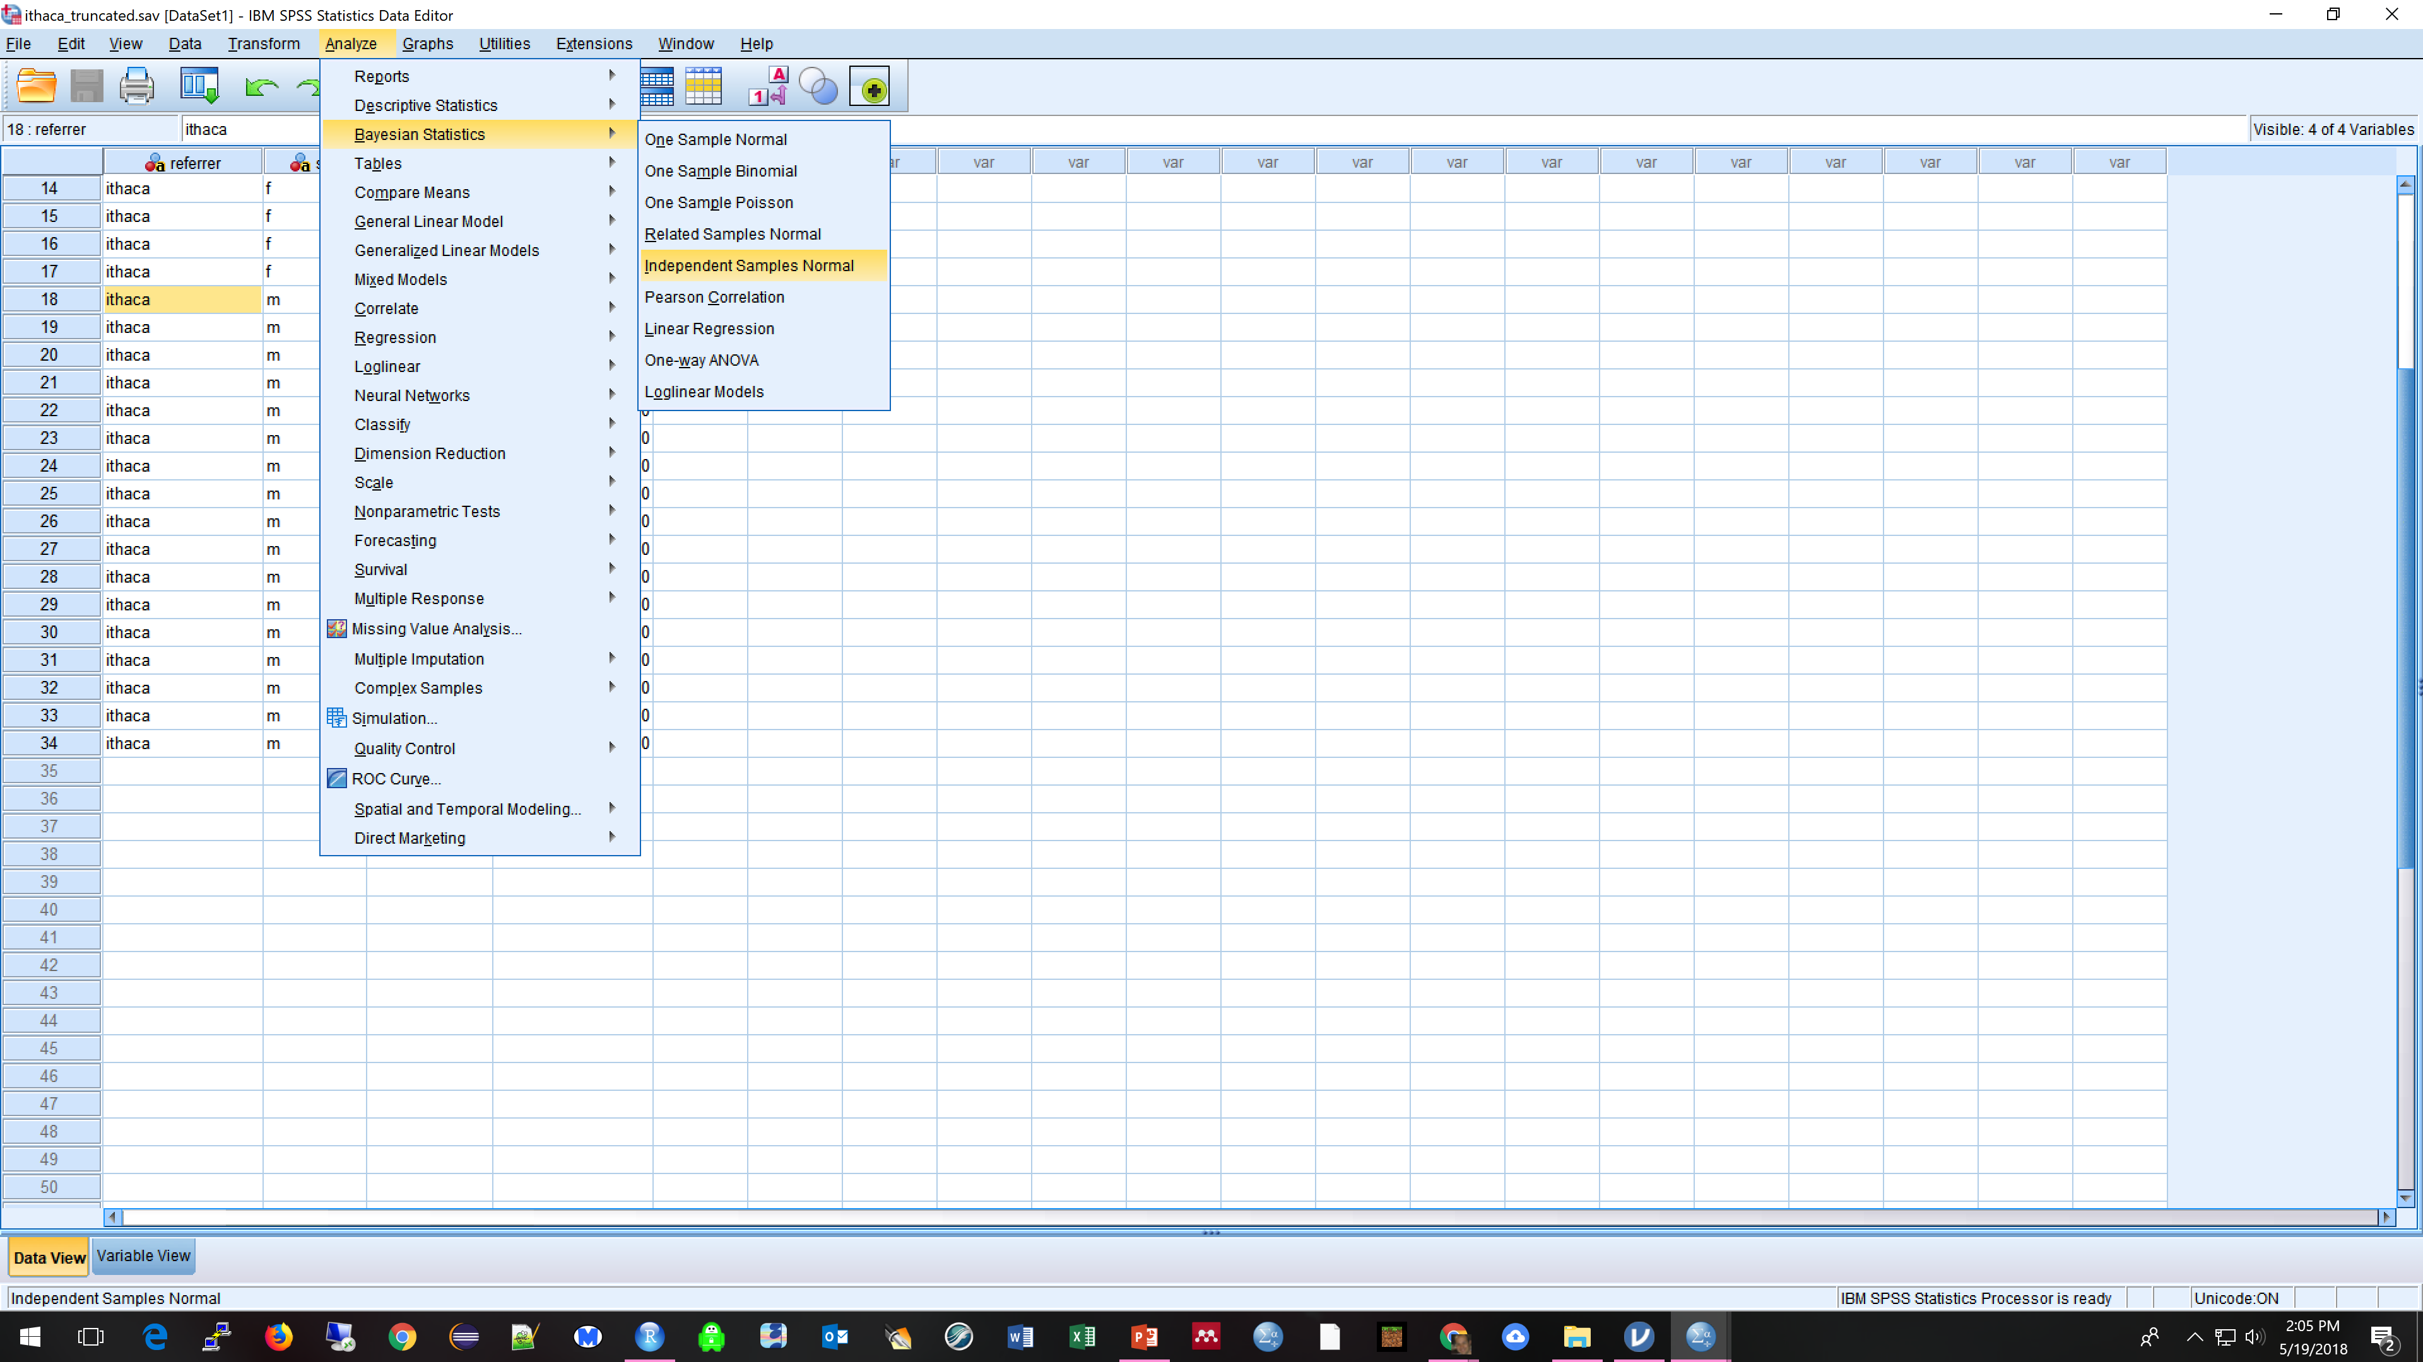

Slide 31
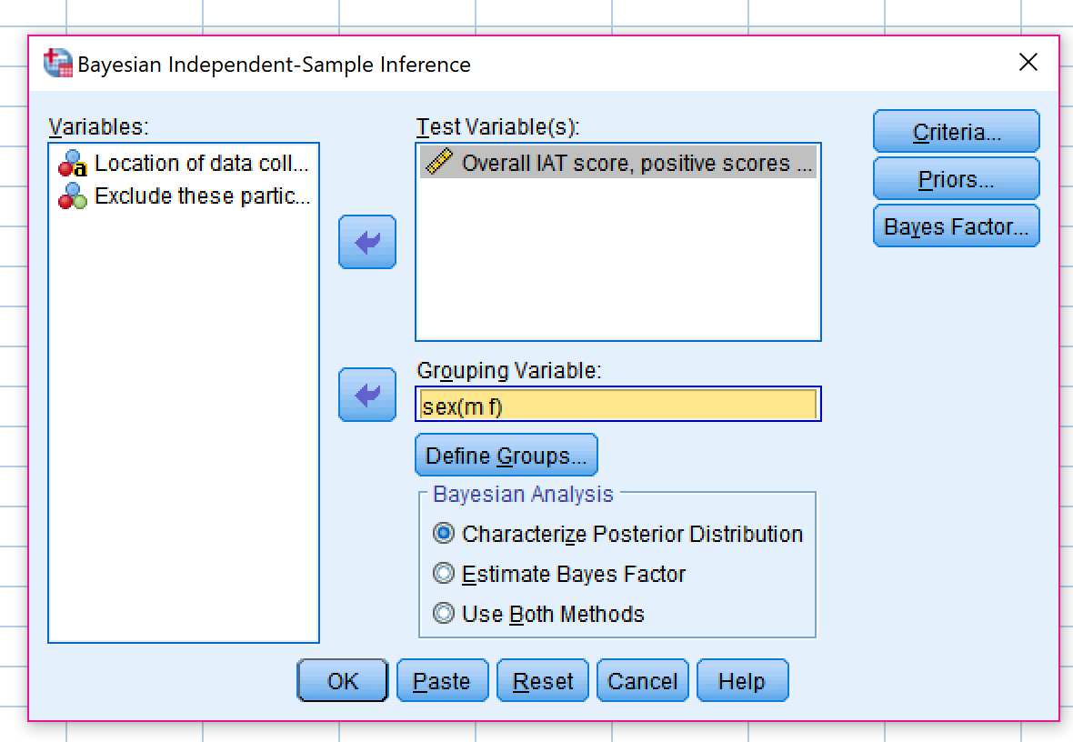

Slide 32
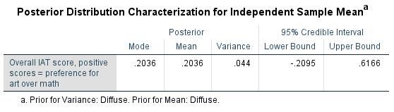
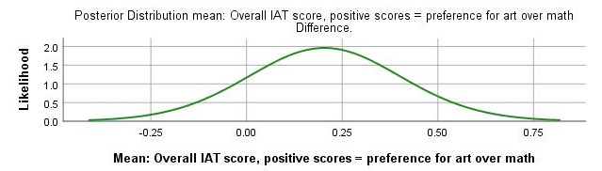
The difference between two means
How about a Bayesian approach?
SPSS 25!?
Males Females
0.28 (.56) 0.48 (0.58)
IAT: 0.15, 0.35, and 0.65 are considered small, medium, and large level of bias for individual scores.
95% Credible interval: -0.21, 0.62
95% Confidence interval: -0.20, 0.60
Small difference due to prior on variance.

Slide 33
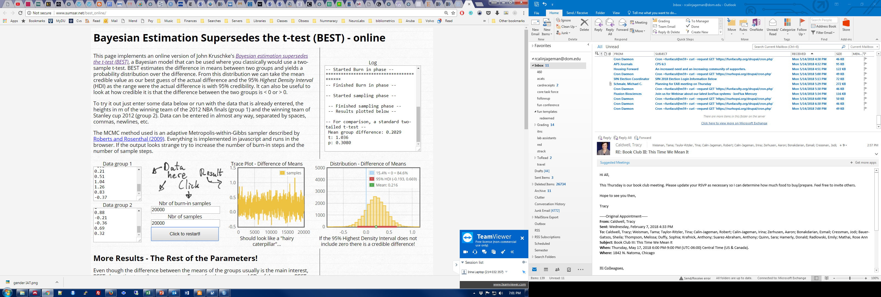

Slide 34
The difference between two means
Partial Ithaca Lab:
Freq: M_{diff} = 0.20, CI[-0.19, 0.60]
BEST: M_{diff} = 0.22, CI[-0.19, 0.67]
Males Females
0.28 (.56) 0.48 (0.58)
IAT: 0.15, 0.35, and 0.65 are considered small, medium, and large level of bias for individual scores.
BEST uses a heavy-tailed t distribution
Otherwise, a credible interval with an uninformed prior ends up with the same boundaries as a confidence interval.

Slide 35
The difference between two means
Two questions that will come up:
What, really, does a CI mean?
How do I judge effect sizes?
Males Females
0.28 (.56) 0.48 (0.58)
IAT: 0.15, 0.35, and 0.65 are considered small, medium, and large level of bias for individual scores.

Slide 36
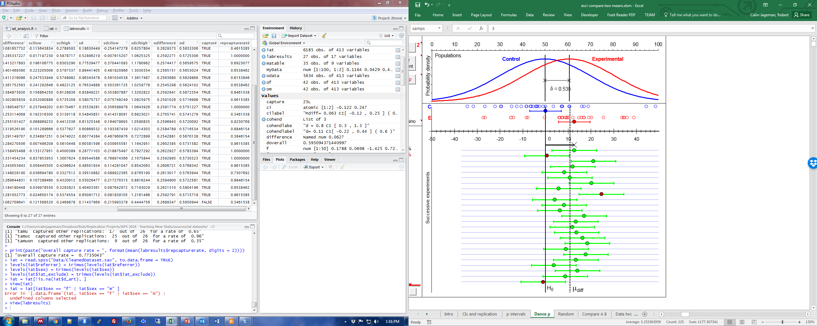
The difference between two means
What does a frequentist CI really mean?
Capture: With ideal circumstances, 95/100 of 95% CIs include the population parameter.
Yours may be red!
Lessons:
Replication is essential!
Confidence is about the process, not about the individual result (each result either captures or does not).
Analogy: Ford’s production line produces only 1 lemon in 100.
99% confident about buying a Ford.
The car you buy will either be a lemon or not.

Slide 37
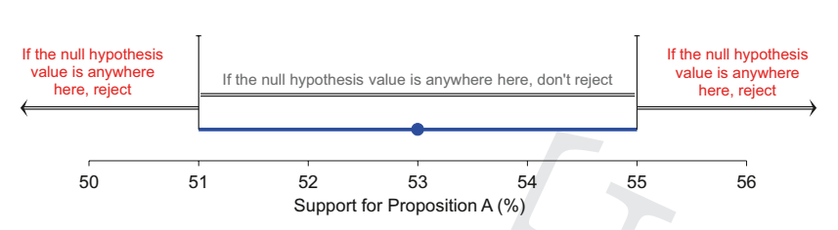
The difference between two means
What does a frequentist CI really mean?
Capture: With ideal circumstances, 95/100 of 95% CIs include the population parameter.
NHST: 95% CI is the set of all null hypotheses that cannot be rejected at α = 0.05
Decision-making comes along for free!
Great for teaching
It means we have nothing to loose and much to gain from this approach.
CI represents the range of parameter values under which the data would not be especially rare.

Slide 38
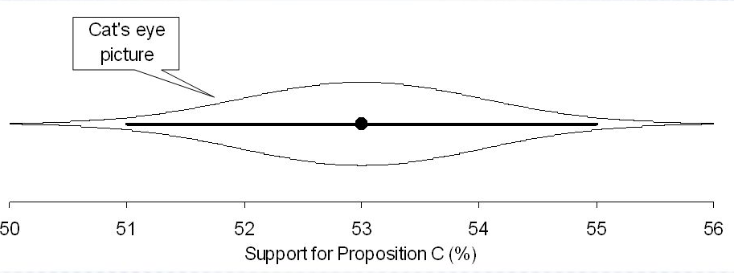
The difference between two means
What does a frequentist CI really mean?
Capture: With ideal circumstances, 95/100 of 95% CIs include the population parameter.
NHST: 95% CI is the set of all null hypotheses that cannot be rejected at α = 0.05
Plausible: Cat’s eye shows how plausibility varies over the CI.
No sharp ending; important to consider the full range of plausible values
Warning: Cat’s eye is a bit controversial for frequentist intervals

Slide 39
The difference between two means
What does a frequentist CI really mean?
Capture: With ideal circumstances, 95/100 of 95% CIs include the population parameter.
NHST: 95% CI is the set of all null hypotheses that cannot be rejected at α = 0.05
Plausible: Cat’s eye shows how plausibility varies over the CI.
Replication: With all else equal (including sample size), a 95% CI has an 83% chance of capturing the mean of the next study.
Qualities of the CI depend on how it was generated and if there was selection in reporting and interpreting it.
The CI estimates the range of likely sampling error under ideal circumstances… in the real world, error is often considerably larger.

Slide 40
The difference between two means
SDSU: M_{diff} = 0.24, 95% CI[0.05, 0.44]
d = 0.48, 95%CI[0.11, 0.85]
How do I judge effect sizes?
Think carefully about the scale of measurement
Standardized effect size measures can be helpful:
http://rpsychologist.com/d3/cohend/
Be careful, though, because these depend on good estimates of variation.
Express in terms of resources for future study:
For 90% power: 92/group, [1738, 30]
Seek context
Women with ~1 hour approach training had lower Math IAT scores compared to those who completed a neutral task, d = 0.55 (Kawakami et al., 2008; highly uncertain!).
On the math portion of the ACT, women score lower than men, d = 0.20.
Test-restest is fairly weak: r around 0.50
Evaluate thoughtfully, tolerate ambiguity and uncertainty
Males Females
0.22 (.48) 0.46 (0.54)
IAT: 0.15, 0.35, and 0.65 are considered small, medium, and large level of bias for individual scores.

Slide 41
The difference between two means
SDSU: M_{diff} = 0.24, 95% CI[0.05, 0.44]
d = 0.48, 95%CI[0.11, 0.85]
Some shifts in thinking:
Quantitative (how much) not qualitative (yes/no)
Much less trust in single studies; evidence comes from synthesis across replications.
Even perfect replications won’t agree 17% of the time!
Some studies are uninformative – stronger emphasis on planning sample sizes, willingness to make no conclusions
Error:
Type M – Magnitude error
Type S – Sign error
No positive/negative dichotomy (an end to publication bias in sight?!)
Some things don’t change
Need the whole story
Beware of selection
GIGO
Males Females
0.22 (.48) 0.46 (0.54)
IAT: 0.15, 0.35, and 0.65 are considered small, medium, and large level of bias for individual scores.

Slide 42
The difference between two means
SDSU: M_{diff} = 0.24, 95% CI[0.05, 0.44]
d = 0.48, 95%CI[0.11, 0.85]
Help students avoid:
Just checking for 0 in the CI
Interpreting only the point estimate and/or only some of the range of the CI
Believing that subsequent replications necessarily will narrow the CI around the current center
Positive/negative dichotomy
Confusing/conflating CI with variation in the sample
Making claims about odds for this CI
Males Females
0.22 (.48) 0.46 (0.54)
IAT: 0.15, 0.35, and 0.65 are considered small, medium, and large level of bias for individual scores.

Slide 43
The difference between two means
SDSU: M_{diff} = 0.24, 95% CI[0.05, 0.44]
d = 0.48, 95%CI[0.11, 0.85]
On average, female participants had relatively strong negative implicit associations about math (M = 0.46, s = 0.54, N = 117). Males also had negative associations with math, but the average is considered a relatively weak negative bias (M = 0.22, s = 0.48, N = 38). Thus, there was a large sex difference in negative implicit attitudes about math (M_{diff} = 0.24 95% CI [0.05, 0.44; d = 0.48 95% CI[0.11, 0.85]). From this sample we estimate that females have stronger negative associations with math, but it is unclear if this difference is very small, moderate, or even very large. More data is required to determine if this association is meaningful or negligible.
Writing samples are really helpful.
The “I do, we do, you do” structure can help scaffold skills.
Males Females
0.22 (.48) 0.46 (0.54)
IAT: 0.15, 0.35, and 0.65 are considered small, medium, and large level of bias for individual scores.

Slide 44
The difference between two means
Student Objectives:
Understand the calculations:
M_{diff} = M₁ – M₂
MoE = t_{conf}(df) * SEM
Effective use of software (estimation and visualization)
ESCI, R, EstimationStats.com – growing list of good options
Thoughtful interpretation
Be quantitative, interpret the full range of the CI, tolerate ambiguity, seek replication and synthesize knowledge
Clear communication
Report descriptive stats (M, s, and N), Mdiff and its CI, standardized effect size and its CI, and an interpretation
Instructor resources:
https://tinyurl.com/newstats-instructor
Email Bob for complete Canvas courses (rcainjageman@dom.edu)

Slide 45
The Plan
Case Studies: Three common designs
Comparing two independent means
Comparing two independent proportions
Estimating interactions
Common themes
Discussion

Slide 46
The difference between two proportions
NHST Approach: The 2x2 Chi Square
Before starting, students should understand
Sampling error
Sampling distributions
Central limit theorem
Standard error of the proportion
Systems of measurement (NOIR)
Basic design consideration (experimental vs. non-experimental)
Let’s re-work an example from NHST to New Stats

Slide 47
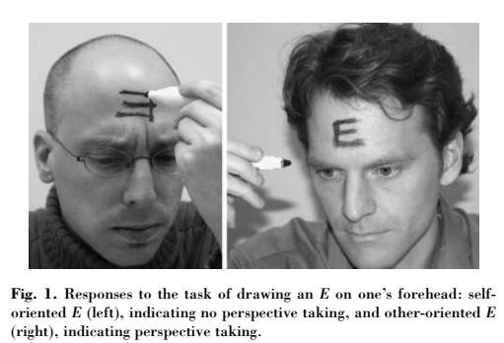
Does Power Produce Egocentric Behavior?
Participants assigned to either Low or High Power condition. After manipulation, all were asked to write an E on their forehead.
χ²(1) = 3.762, p = .025 (one-tailed)
Power fosters egocentric behavior.
 | Other-Centric | Ego-Centric
Neutral | 4 | 29
Power | 8 | 16
Data from Galinsky et al.. (2006)

Slide 48
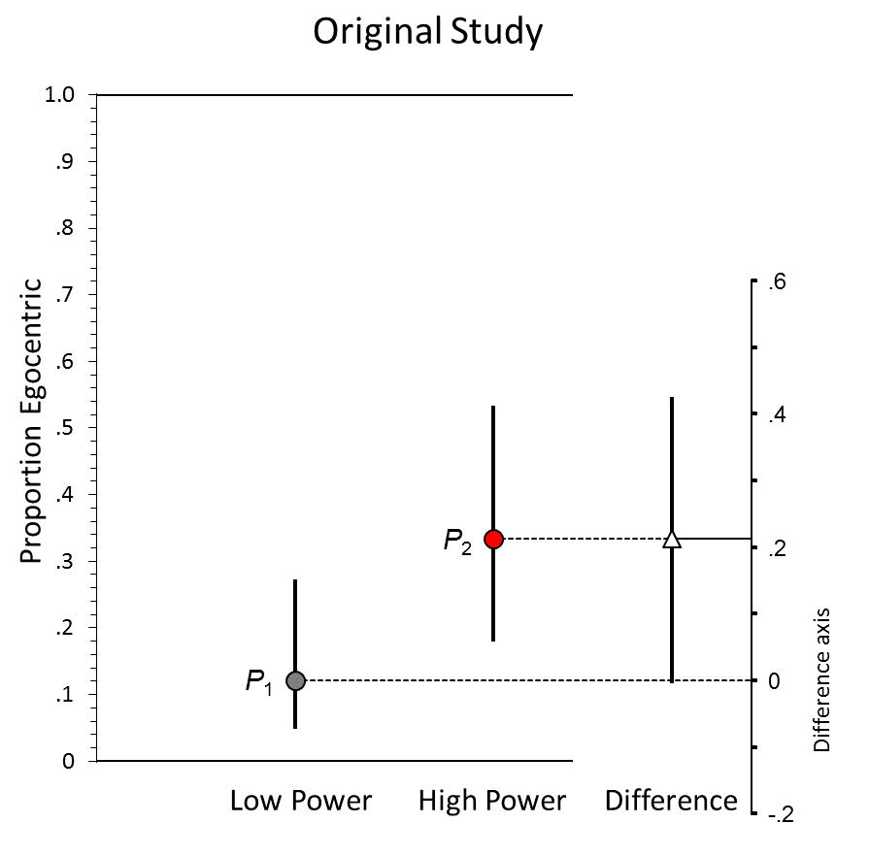
How Much Does Power Foster Egocentric Behavior?
Participants assigned to either Low or High Power condition. After manipulation, all were asked to write an E on their forehead.
Quantitative question with effect-size answer
In low power, P_{egocentric} = .12 (4/33)
In high power, P_{egocentric} = .33 (8/24)
Diff in Proportion = .21, 95% CI [-.00, .43]
We estimate power could have anywhere from effectively 0 effect up to a very large effect on ego-centric behavior.
Power probably does not decrease egocentric behavior.
χ²(1) = 3.762, p = .025 (one-tailed)
Power fosters egocentric behavior.
 | Other-Centric | Ego-Centric
Neutral | 4 | 29
Power | 8 | 16
Interpretation takes uncertainty seriously (whole CI)
Plot shows data, effect size, and CI
Data from Galinsky et al.. (2006)

Slide 49
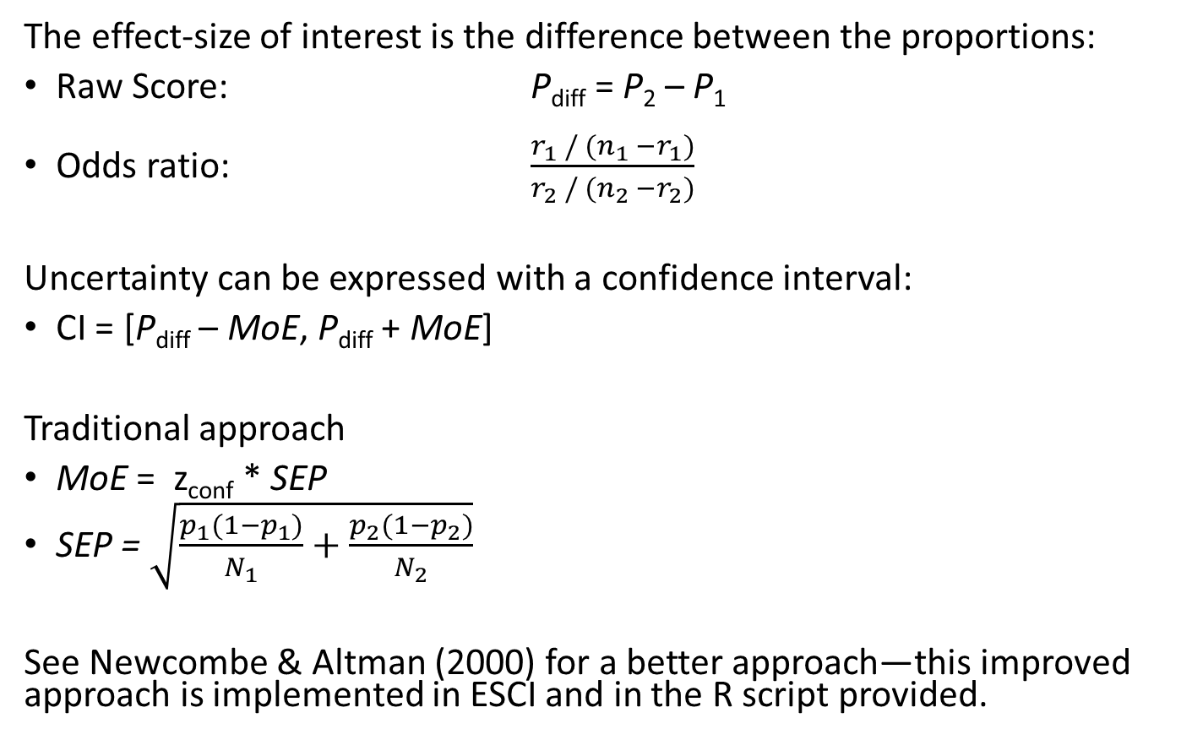
The difference between two proportions
The effect-size of interest is the difference between the proportions:
Raw Score: P_{diff} = P₂ – P₁
Odds ratio: $\frac{r_{1} / (n_{1} −r_{1})}{r_{2} / (n_{2} −r_{2})}$
Uncertainty can be expressed with a confidence interval:
CI = [P_{diff} – MoE, P_{diff} + MoE]
Traditional approach
MoE = z_{conf} * SEP
SEP = $\sqrt{\frac{p_{1}(1−p_{1})}{N_{1}}+\frac{p_{2}(1−p_{2})}{N_{2}}}$
See Newcombe & Altman (2000) for a better approach—this improved approach is implemented in ESCI and in the R script provided.

Slide 50
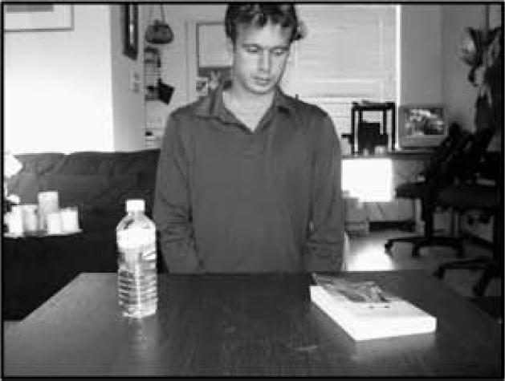
How Much Does Power Foster Egocentric Behavior?
From Tversky & Hard, 2009 without permission
Participants assigned to either Low or High Power condition. After manipulation, all were asked to write an E on their forehead.
On which side of the table is the book?
 | High Power |  | Low Power
 | Ego-Centric | Total | Ego-Centric | Total
Galinsky et al. (2006) | 8 | 24 | 4 | 33
My Lab, In Person | 17 | 80 | 19 | 71
My Lab, Mturk | 48 | 105 | 33 | 101
My Lab, Prolific Academic | 44 | 122 | 45 | 133
Blader et al., 2016, S4 | 57 | 78 | 46 | 79
Laurent & Lester, Unpublished | 18 | 71 | 22 | 70

Slide 51
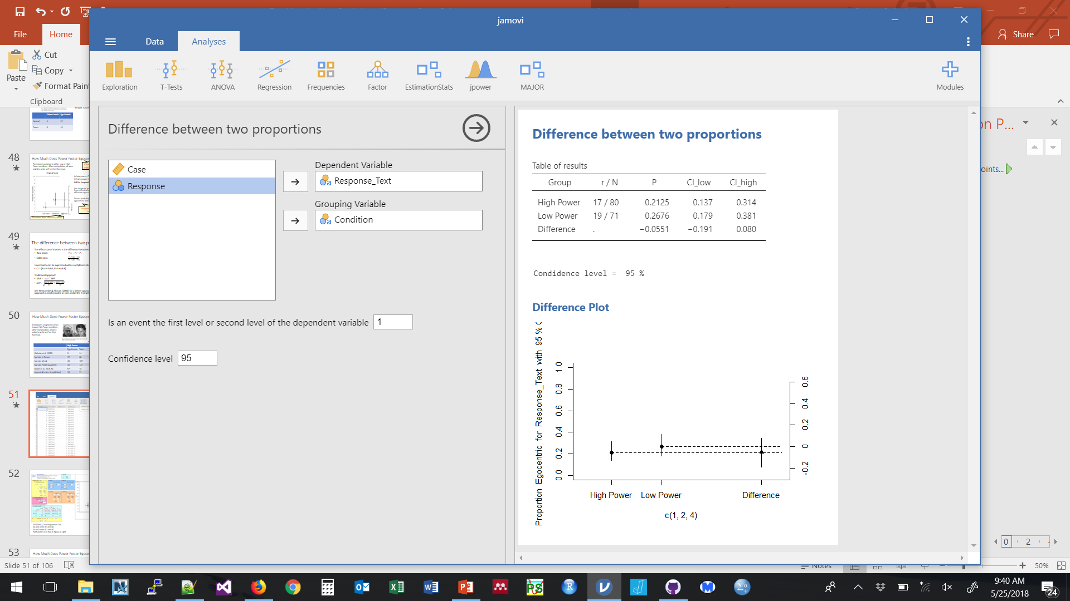
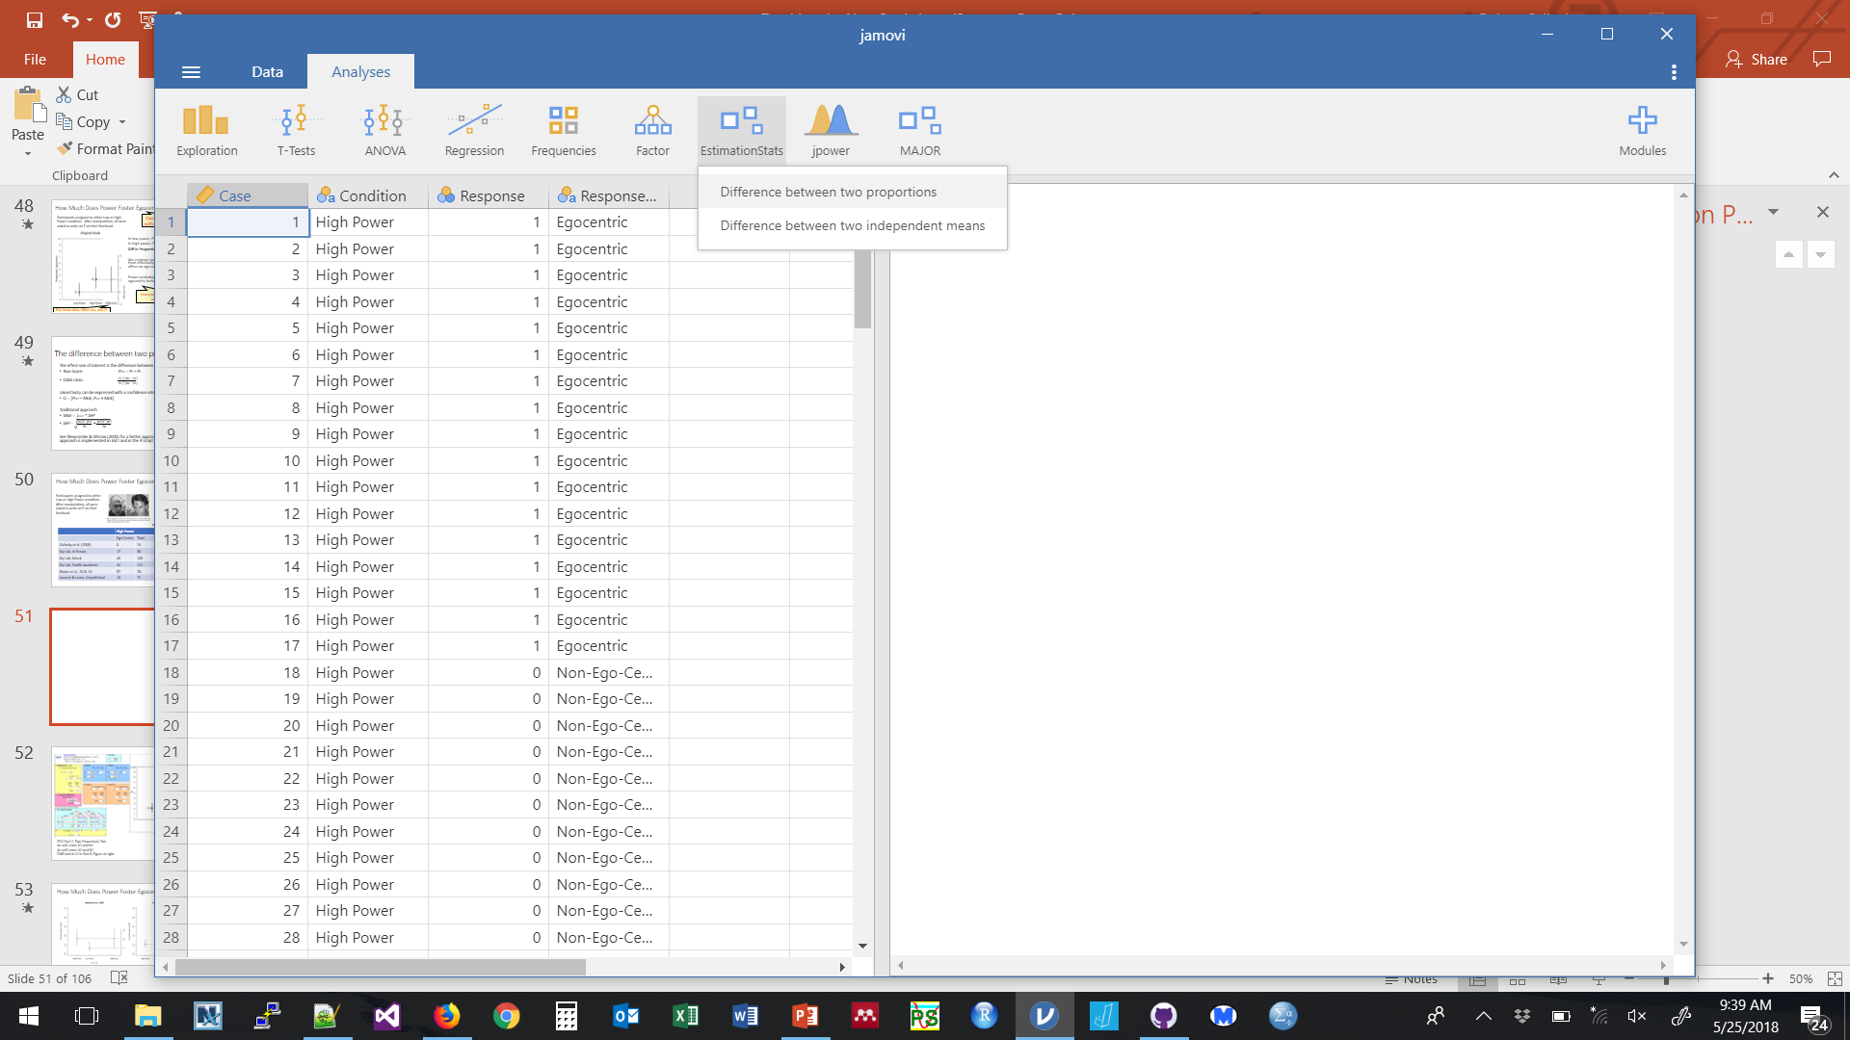
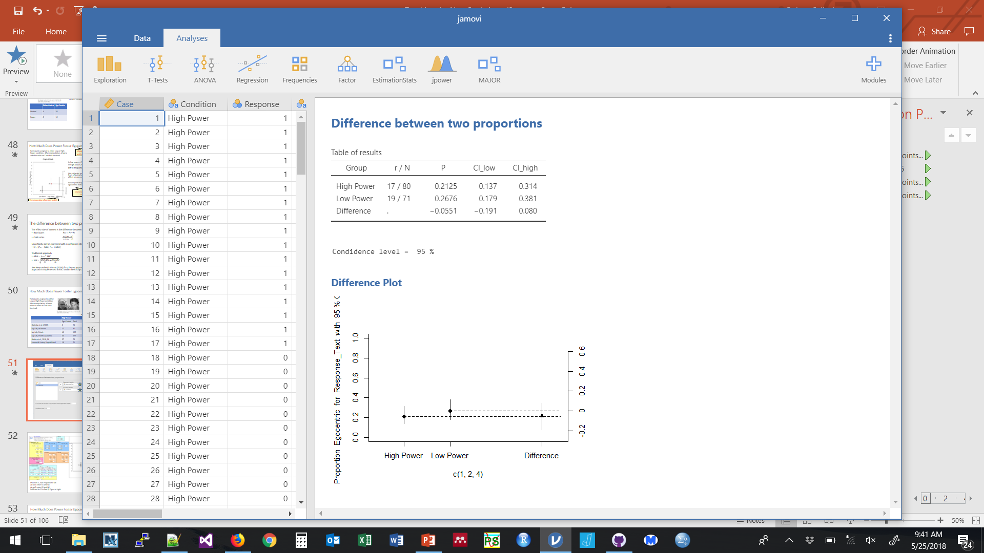

Slide 52
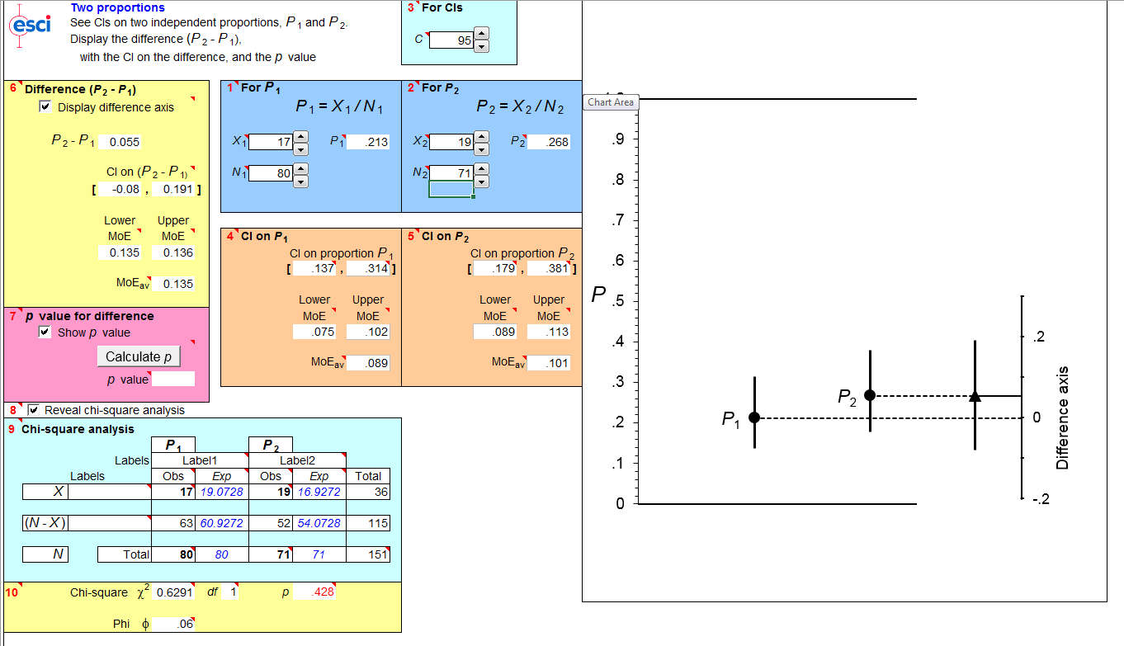
ESCI Part 2, Two Proportions Tab
At red1 enter X1 and N1
At red2 enter X2 and N2
Pdiff and its CI in Red 6, Figure at right

Slide 53
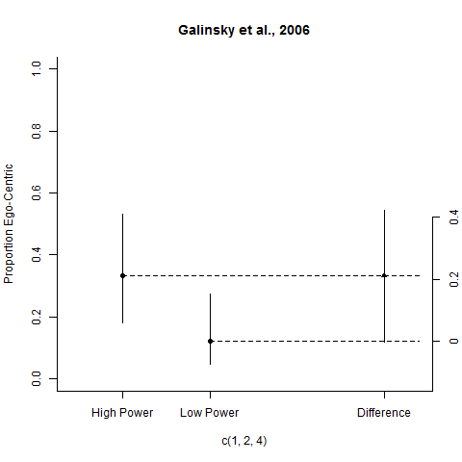
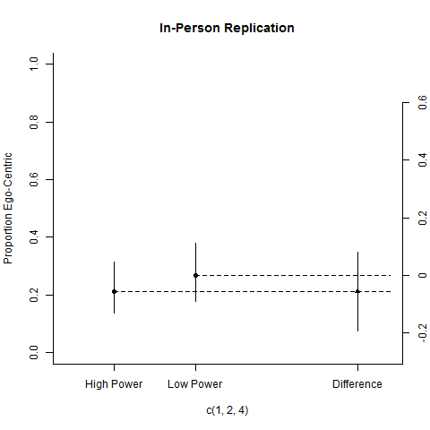
How Much Does Power Foster Egocentric Behavior?
In the replication study, those in the high power condition were actually a bit less ego-centric. From this data alone we would estimate a decrease in the proportion choosing the ego-centric behavior, P_{diff} = -.05 95% CI[-.19, .08], but the CI is long and consistent with anywhere from a strong decrease, to no decrease, to even a moderate increase in egocentric behavior. The strong increase in the original study is not in the replication CI.

Slide 54
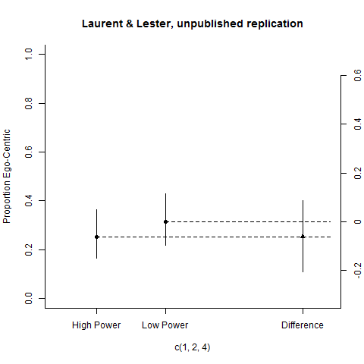
How Much Does Power Foster Egocentric Behavior?
In this unpublished replication, those in the high power condition were actually a bit less ego-centric. From this data alone we would estimate a decrease in the proportion choosing the ego-centric behavior, P_{diff} = -.06 95% CI[-.20, .09], but the CI is long and consistent with anywhere from a strong decrease, to no decrease, to even a moderate increase in egocentric behavior. The strong increase in the original study is not in the replication CI.

Slide 55
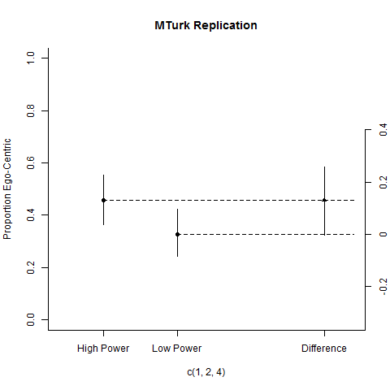
Does Power Produce Egocentric Behavior?
In this online conceptual replication on MTurk, those in the high power condition were considerably more ego-centric. From this data alone we would estimate an increase in the proportion choosing the ego-centric behavior, P_{diff} = .13 95% CI[-.00, .26]. Note the CI is long: it ranges from no difference to a very weak difference up to the strong difference found in the original study.

Slide 56
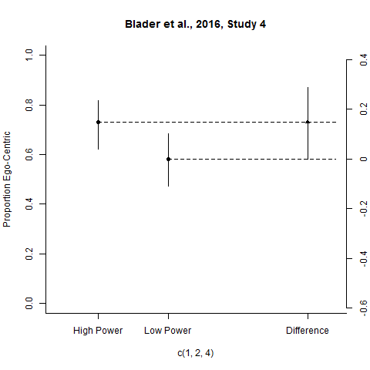
How Much Does Power Foster Egocentric Behavior?
In Blader et al.’s conceptual replication on MTurk, those in the high power condition were considerably more ego-centric. From this data alone we would estimate an increase in the proportion choosing the ego-centric behavior, P_{diff} = .15 95% CI[-.00, .28]. Note the CI is long: it ranges from no difference to a very weak difference up to the strong difference found in the original study.

Slide 57
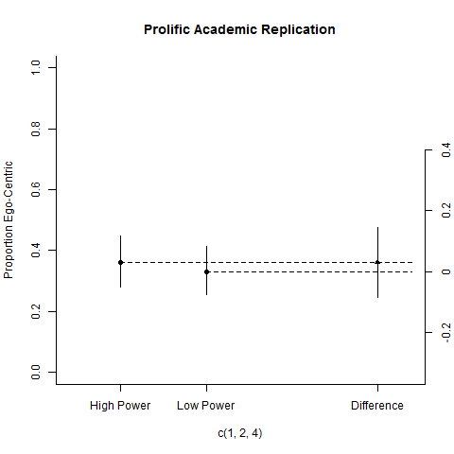
How Much Does Power Foster Egocentric Behavior?
In this online conceptual replication on Prolific Academic, those in the high power condition were slightly more ego-centric. From this data alone we would estimate an increase in the proportion choosing the ego-centric behavior, P_{diff} = .03 95% CI[-.09, .15]. Note the CI is long: it ranges from a moderate to decline to no difference to a moderate increase in ego-centric behavior. The strong increase found in the original study is not in the replication CI.

Slide 58
How Much Does Power Foster Egocentric Behavior?
Focus is on the effect and its uncertainty
Avoid +/- dichotomy
Tolerate ambiguity—be willing to draw no conclusion or limited conclusions
Seek replication and synthesis

Slide 59
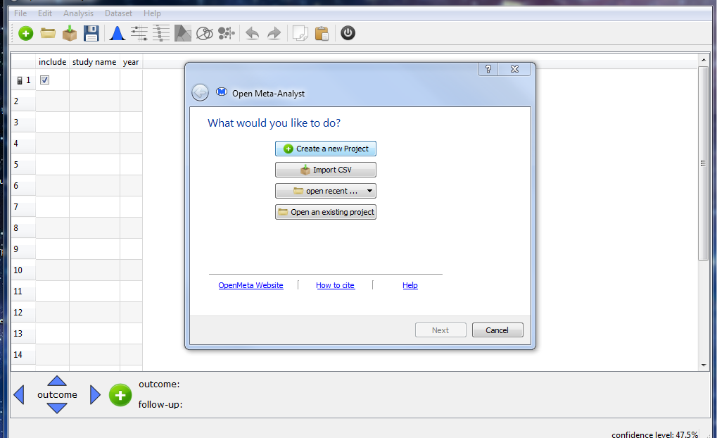
How Much Does Power Foster Egocentric Behavior?

Slide 60
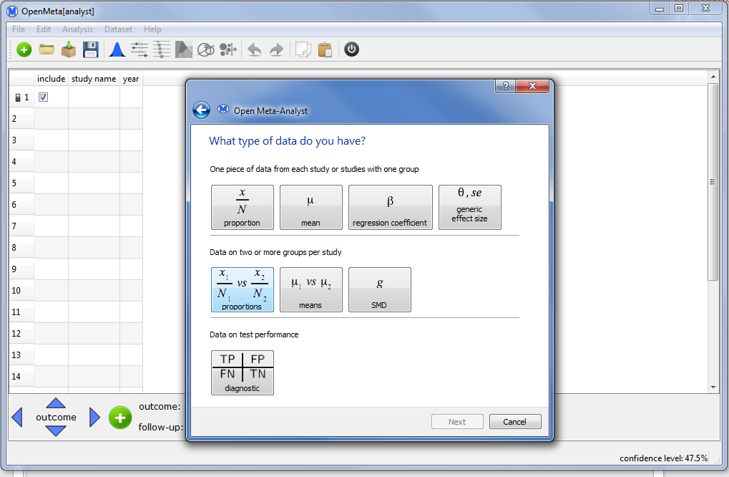
How Much Does Power Foster Egocentric Behavior?

Slide 61
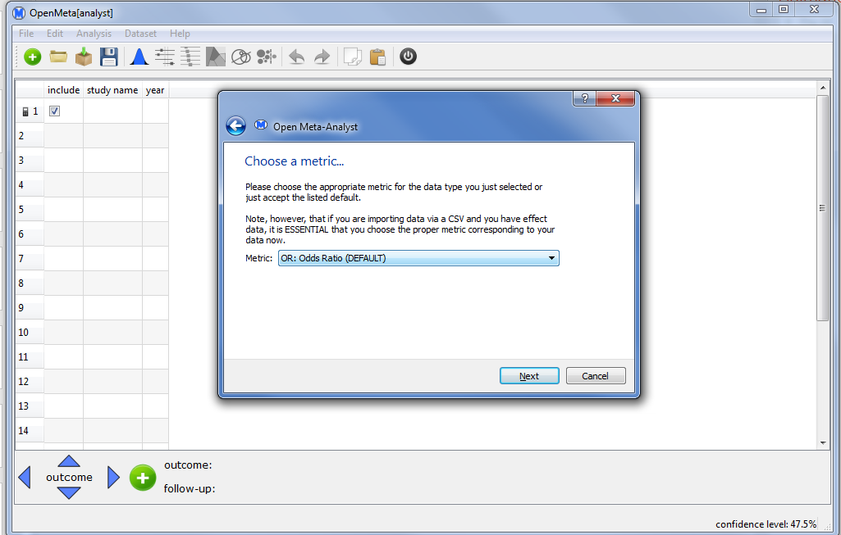
How Much Does Power Foster Egocentric Behavior?

Slide 62
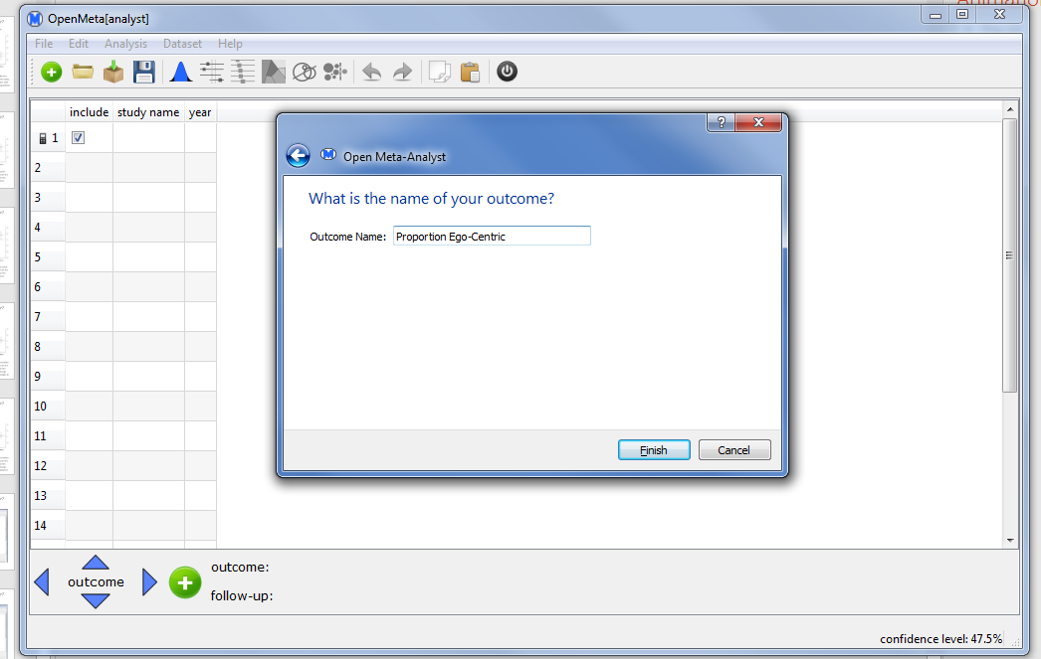
How Much Does Power Foster Egocentric Behavior?

Slide 63
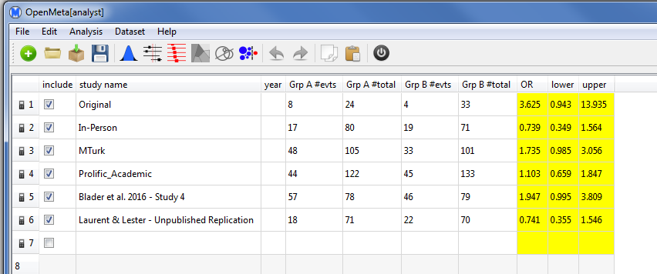
How Much Does Power Foster Egocentric Behavior?

Slide 64
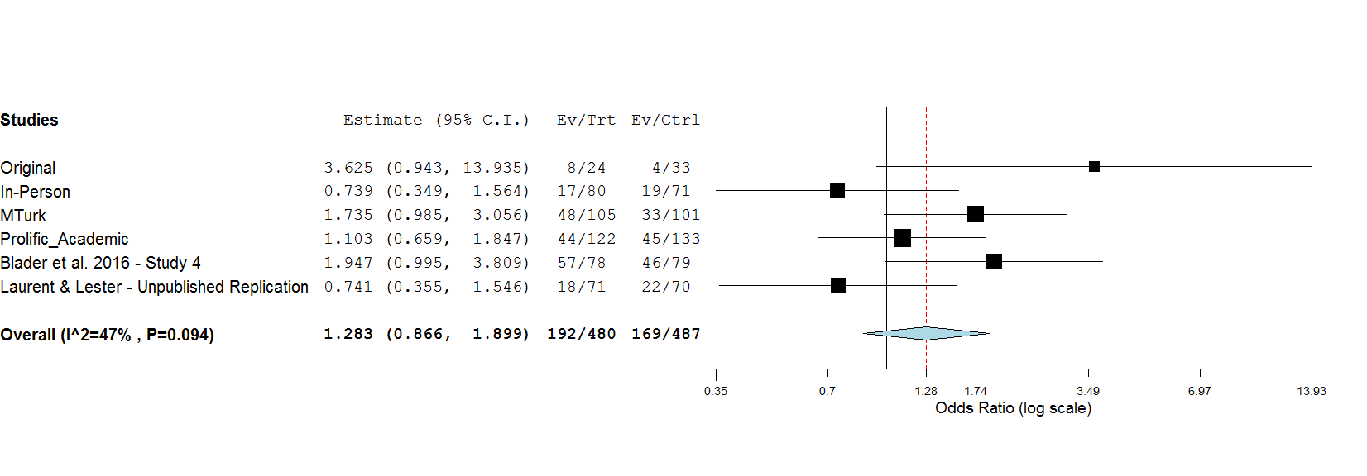
How Much Does Power Foster Egocentric Behavior?
Overall OR is 1.283 [0.866, 1.90].
To what degree are the replication results expected based on the original study? Explain your answer.
This is a long CI, compatible with a range of possibilities:
Power could somewhat decrease ego-centric behavior
There may be no effect
Power could increase ego-centric behavior: very slightly, moderately, or even somewhat strongly
Strong heterogeneity: Moderators? More data needed? Not clear.

Slide 65
The difference between two proportions
Student Objectives:
Understand the calculations:
P_{diff} = P₁ – P₂
See Newcombe & Altman, 2000 for CI approach
Effective use of software (estimation and visualization)
ESCI, R, Open Meta Analyst
Thoughtful interpretation
Be quantitative, interpret the full range of the CI, tolerate ambiguity, seek replication and synthesize knowledge
Clear communication
Report counts and proportions for each group, P_{diff} and its CI, and an interpretation.

Slide 66
The Plan
Case Studies: Three common designs
Comparing two independent means
Comparing two independent proportions
Estimating interactions
Common themes
Discussion

Slide 67
2x2 Factorial Design
NHST Approach: The 2-Way ANOVA
Before starting, students should understand
Sampling error
Sampling distributions
Central limit theorem
Standard error of the mean
Margin of error of the mean
Systems of measurement (NOIR)
Basic design consideration (experimental vs. non-experimental)
Let’s re-work an example from NHST to New Stats

Slide 68
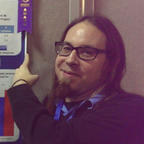
Does Environment Interact with Study Technique to Determine Learning?
IV1: Study Technique
Re-reading
Self-explaining
IV2: Study environment
Quiet
Loud music
To what extent does study environment alter the benefits of self-explaining?
Jason Geller, a co-author on “The Replication Recipe”
Geller and Calin-Jageman, 2012, Study 1

Slide 69
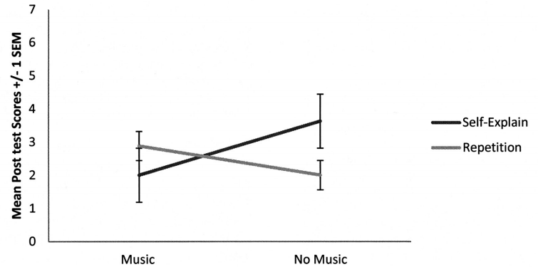
Does Environment Interact with Study Technique to Determine Learning?
Loud Quiet
No main effect of study technique, F(1,28) = 0.39, p = .54
No main effect of music, F(1,28) = 0.39, p = .54
A significant interaction, F(1,28) = 4.33, p = .048
Ugh.
Geller and Calin-Jageman, 2012, Study 1

Slide 70
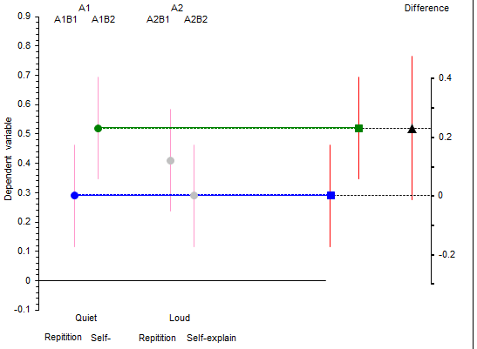
In a quiet room, SE could help a lot: +23%, CI[-1, +47]
Geller and Calin-Jageman, 2012, Study 1

Slide 71
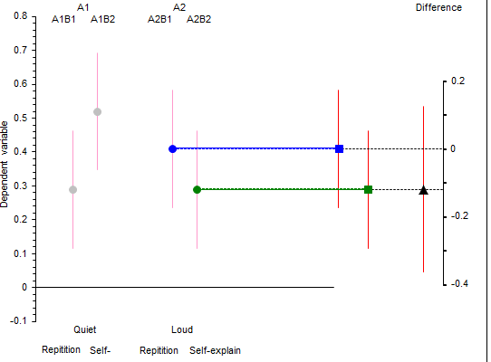
In a quiet room, SE could help a lot: +23%, CI[-1, +47]
With music, SE could hurt a bit: -12%, CI[-36, +12]
To what extent are these differences different?
Geller and Calin-Jageman, 2012, Study 1

Slide 72
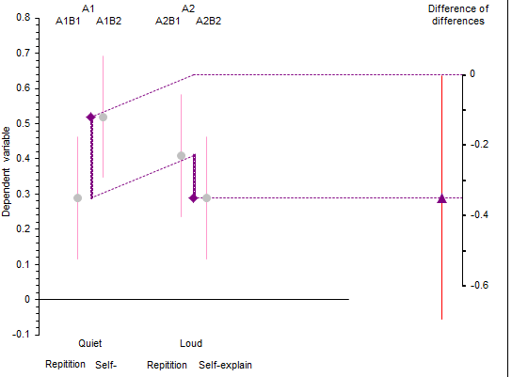
In a quiet room, SE could help a lot: +23%, CI[-1, +47]
With music, SE could hurt a bit: -12%, CI[-36, +12]
Music decreases SE effect by very very little to a lot:
∆d = -35%, CI [-63, -1]
Geller and Calin-Jageman, 2012, Study 1

Slide 73
Does Environment Interact with Study Technique to Determine Learning?
Quiet - Repetition
n | 7
M | 2.63
s | 1.2
Loud - Repetition
n | 7
M | 2.25
s | 1.3
Quiet – Self-Explain
n | 7
M | 4.13
s | 1.5
Loud – Self-Explain
n | 7
M | 1.25
s | 1.6
Use ESCI Part 2, Ind groups 2x2 Tab
Enter labels for A at Red 3: Quiet, Loud
Enter Labels for B at Red 3: Repetition, Loud
Enter summary data for each cell
Geller and Calin-Jageman, 2012, Study 2

Slide 74
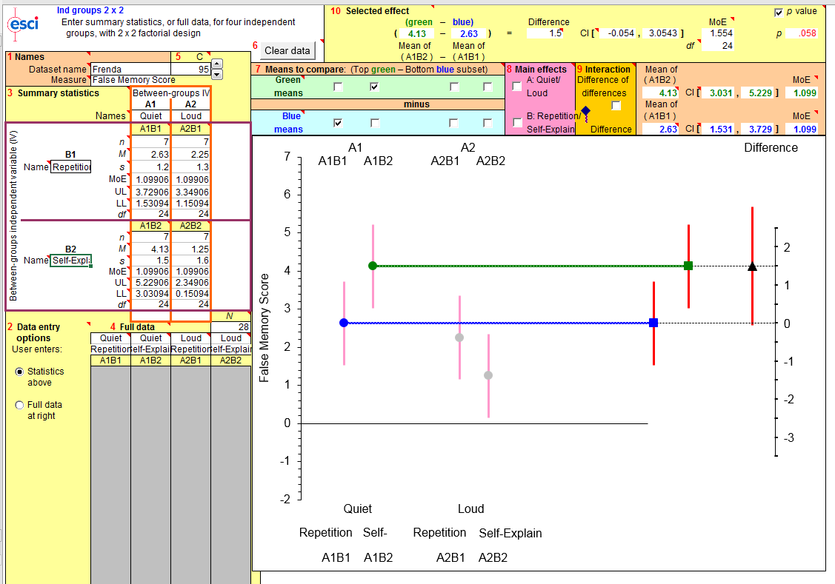
Does Environment Interact with Study Technique to Determine Learning?
Describe each simple effect, then the interaction

Slide 75
Does Environment Interact with Study Technique to Determine Learning?
In a quiet environment, self-explaining improved scores substantially: M_{diff} = 1.5 [-0.1, 3.1]

Slide 76
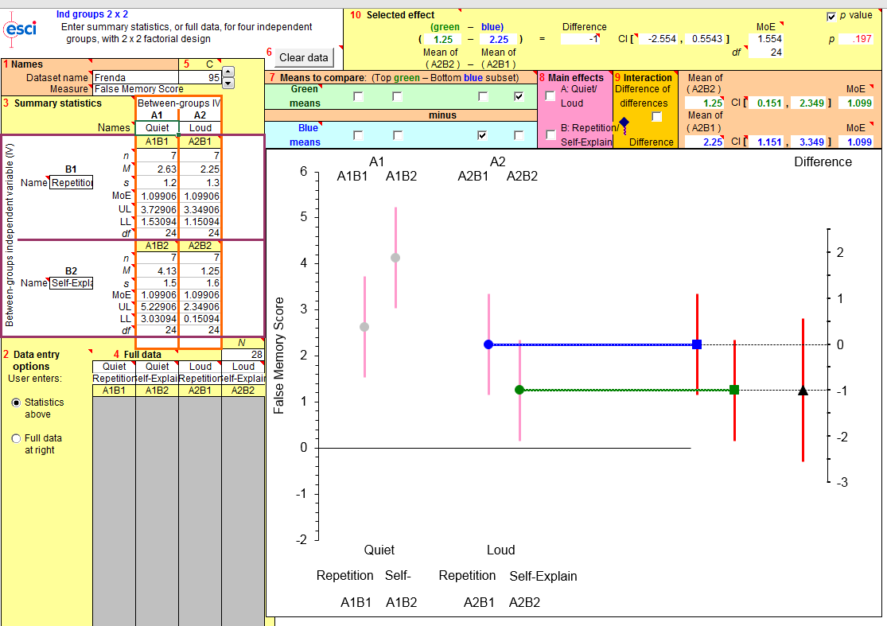
Does Environment Interact with Study Technique to Determine Learning?
In a quiet environment, self-explaining improved scores substantially: M_{diff} = 1.5 [-0.1, 3.1]
In a loud environment, self-explaining moderately decreased scores: M_{diff} = -1 [-2.6, 0.6]

Slide 77

Does Environment Interact with Study Technique to Determine Learning?
In a quiet environment, self-explaining improved scores substantially: M_{diff} = 1.5 [-0.1, 3.1]
In a loud environment, self-explaining moderately decreased scores: M_{diff} = -1 [-2.6, 0.6]
Thus, music had a strong moderating effect on study strategy: ∆ ∆ = -2.5 [-4.7, -0.3]
The CI is long, so it is unclear if this is a weak, moderate, or very strong moderator.

Slide 78
Factorial Design with Estimation
New Stats approach is based on analysis of targeted contrasts (k-1 or fewer is suggested)
For interactions: the difference on the difference is an intuitive quantitative measure of moderation
In general, CI is longer than for main effects
This approach does not strongly rely on the ANOVA table
This approach does not adjust for multiple comparisons when comparisons are planned and limited (k-1 or fewer)
Remember, ANOVA has no adjustment for multiple comparisons across F tests (Cramer, 2016)

Slide 79
Summary
Estimation is based on the same foundations as decision-making and enables decision making when needed.
Estimation does involve significant shifts in thinking:
Quantitative rather than qualitative
Uncertainty is paramount
Requires judgement about effect sizes
Replication and meta-analysis as a matter of course
No positive/negative dichotomy
Often the effect size itself requires a shift in thinking from the decision-making approach
Difference between two proportions
Factorial design: focus on specific contrasts rather than omnibus F

Slide 80
Pedagogical Conversations
Your “Statistics Ecosystem”
Class sequencing
Various sections/instructors
Cross departments
Transitional Strategies for the Classroom
Content
What do you tell your students?
Assessment
Software
Beneficial Side Effects

Slide 81
Statistics Ecosystem
Considerations for Incorporating the New Statistics
Class sequencing
Do your statistics courses feed into upper level courses?
What expectations are in place for students to know coming out of you statistics course?
Various sections/instructors
Does your department have a standard syllabus?
Can/how does this change?
Multiple instructor issues/concerns?
Cross departments
Do other departments use your statistics courses for their students? What are their content expectations?
A summer ‘stats day’ can help build consensus
A standardized set of materials as a starting point can help with onboarding new faculty
Your concerns/problems/solutions?

Slide 82
Making room in the syllabus: Make if fit?
Old stats and new stats together
Can strain an already crowded syllabus
Students tend to gravitate towards the yes/no aspect of decision-making, even if they don’t understand it.
New Stats only
Feels scary, especially in terms of reading the prior literature
Some type of blend… but how?
Lead with the new stats
Teach decision-making as one way to use a CI (to check the plausibility of a specific hypothesis)
Most of decision-making ends up coming along for free
Can de-emphasize some decision-making not as relevant to effect sizes
ANOVA tables and omnibus F, post-hoc tests
Observed/expected calculations in Chi square
Blend in meta-analysis informally throughout, decreasing time for formal coverage
Planning for precision is easy and takes much less time to cover than planning for power
In general, estimation builds more clearly between simple and complex designs
GAISE has some guidance here as well…

Slide 83
Transitional Strategies for the Classroom
GAISE suggests the REMOVAL the following from statistics courses:
Probability theory
Constructing plots by hand
Basic statistics. Histograms, pie charts, scatterplots, means, and medians*
Drills with z-, t-, χ 2 , and F-tables.
Advanced training on a statistical software program
DISCUSS: How (and what) have we removed or integrated

Slide 84
Transitional Strategies for the Classroom
What do you tell your students?
Nothing: just proceed as if this is what you do
Full disclosure: start with the replication crisis, problems with p-values, etc.
Something in the middle?
Pros and Cons:
Could feel like they are “guinea pigs” if told this is new and experimental?
Could learn the new methods well, but be blindsided by traditional methods in the future?
Might not care either way?
Discuss: Approaches to framing these changes for students

Slide 85
Assessment
As recommended by the GAISE, it is important to assess impact
APA PASS: Project Assessment gives psychology specific tools
ARTIST Project: more traditional statistical course content
Specific Tools might include:
Research Methods Skills Assessment (Smith & Smith, 2018)...full disclosure, it’s mine!
Assessing Statistical Literacy, (Ronquillo-Adachi & McCormack, 2018)

Slide 86
Assessment
Measures that are reliable and valid and specific to the new statistics are needed…
In the meantime, think about how you will assess on assignments and exams:
What are the important outcomes for an assignment and what dictates a “correct” answer?
Example: If the results of an analysis between two groups are given with error bars, p-value, and Cohen’s d, what conclusions would you accept as “correct”? How would you ask the question?

Slide 87
Assessment: Old vs. New
OLD VERSION (testing mechanics/surface knowledge):
N M(SD) 95% CI
Men 100 5.00(1.00) (4.80, 5.20)
Women 100 3.00(1.00) (2.80, 3.20)
Question: Are the men and women’s mean scores significantly different?
Answer: YES
How do you know: Because 0 is not in the confidence interval/confidence intervals do not overlap/result of t-test has p<.05.

Slide 88
Assessment: Old vs. New
NEW VERSION (tests mechanics/surface knowledge AND conceptual understanding):
N M(SD) 95% CI
Men 100 5.00(1.00) (4.80, 5.20)
Women 100 3.00(1.00) (2.80, 3.20)
Question: Are the men and women’s mean scores significantly different? How often and how much do we expect men and women mean scores to differ?
Answer: We expect men and women to differ most of the time. The difference between men and women will be about 2 points, which is two times a standard deviation. On the scale of annoyance, ranging from 1 to 5, a shift in two points indicates a much greater amount of annoyance. From this single study, we can be quite confident that men will be more sustainably more annoying than women in most samples, supporting the claim that girls rule and boys drool.
How do you know: Because 0 is not in the confidence interval/confidence intervals do not overlap/result of t-test has p<.05. Do you even need to ask this? It’s already in the answer above!

Slide 89
Do Students Really Get More Conceptual Knowledge from learning the New Statistics?

Slide 90
Example of Portfolio Outcomes
YES!
Students complete a final portfolio illustrating their ability to analyze data in a variety of ways.
One exhibit utilizes an independent samples t-test
The following two examples are taken from the 'old' and 'new' statistics curriculum.
The 'old' example is from an A student who scored all points on this exhibit.
The 'new' example is NOT from an A student, but nonetheless illustrates their deep conceptual understanding far beyond that of the first example.

Slide 91

OLD:
The two independent samples analyzed were the scores divided by whether students' GPAS were above or below 2.50 (low v. high). We started by running a power analysis with an alpha level of .05, two-tails, effect size of .50, and power of .80. The results were that the two groups should include samples sizes of at least 33 and 105. The low GPA group had an average score of M=.53(.18) and the high GPA group had an average of M=.51(.18). The t-test was not significant, t(27)=.93, p=.35, d=.14. The results were not significant and accordingly, the effect size was fairly small. However, it was surprising to see that the students with a slightly lower GPA actually had a slightly higher mean than the students in the high GPA group.

Slide 92

New

Slide 93
We conducted an independent samples t-test to determine the size of the difference between both the psych up and the general admit group. The purpose for doing this test is to help compare the means of the two groups. This graph above shows the group descriptive between the general admit and the psych up student. The error bar graph above compares the means of both groups in order to determine whether there is statistical evidence that the associated population means are significantly different.
The psych up student show a high PGD, which is good because their test score is low, but they show a high PDG (effort). The general admit mean score is M=5.97, and it shows a confidence interval that tells us about future data and will have an average score in this ranges. The CI is displayed in the graph by the two bars extending from the mean score. The pych up student however mean scores is 6.88 and it has a confidence interval which is an error bar that spreads above and below the dot. The two groups do not overlap because they are far apart. The t-test results was t(229)=-3.73, p<.001, d=-.99. The effect size of d=.99 indicates that in terms of letter grade its one letter grade. based on the data it seems that the size of the difference between the two groups suggest that the Psych-up students have a high PGD that will help them be successful.

Slide 94
What software to use?
Package | Effect Sizes and CIs | d and CI | Good figures | Data management
SPSS | Sometimes |  |  | ✔
ESCI | ✔ | ✔ | ✔
JASP | ✔ | ✔ |  | ✔
JAMOVI | ✔ | With module | With module* | ✔
multicon package in R | ✔ | With MBESS | ✔ | ✔
estimationstats.com | ✔ |  | ✔
Bayesian
BEST (webapp or scripts for R, JAGS, and rjags) | ✔ | ✔ | ✔ | Yes, in R
SPSS | ✔ |  | Meh | ✔
No perfect options, but:
ESCI does everything but good data management
Jamovi is getting there; module will keep improving

Slide 95
Beneficial Side Effects
Not only does conceptual understanding increase, but other non-cognitive factors are positively affected as well.

Slide 96


Cycle of Statistics Apprehensions
I’m not so good at this…
Beliefs about Ability
Directions: Read each question carefully...
Performance
Interest & Value; Difficulty; Anxiety
Effort & Engagement
Notes:
Students beliefs set the stage for their interest in a subject, their value of that subject, how difficult they perceive it to be as well as the anxiety they will experience when studying the subject. If a student believes that they are not capable of doing well at something (“math and numbers just arn’t my thing”) they will be less interested in attempting to learn statistics and hold less value for the subject. THis makes sense as we move away from things we feel we are going fail (decreased interest) and justify these behaviors in terms of value (“it’s okay if I don’t do great in stats, because I’m not going to do research anyway”. Unfortunately, when students are faced with taking statistics despite the fact that they don’t feel capable in the subject, they will develop anxiety, and as mentioned this has implications for their working memory. Lower interest and value are also tied to less engagement and lower levels of effort (REFS). Ultimately, this leads to lower performance.

Slide 97

What is Mindset?
Beliefs about where intelligence comes from (Dweck, 2006)
FIXED MINDSET: Individuals who believe that intelligence is a static & innate
GROWTH MINDSET: Individuals who believe that intelligence is malleable and can be changed overtime with effort and careful incorporation of feedback into one’s behaviors.
One’s mindset has many implications (see Dai & Cromly, 2014)
Motivation (see Dweck, 2015)
Anxiety (King, McInerney, & Watkins, 2012; Smith & Capuzi, 2017)
Performance (Blackwell, Trzesniewski, & Dweck, 2007; Boaler, 2013;
Paunesku et al., 2015)
Brain activity and development (Moser, Schroder, Heeter,
Moran, & Lee, 2011)
Notes:
In this presentation, theories of beliefs of intelligence are referred to as “mindset”. Mindset has a very specific meaning in this context. It refers to the belief that someone holds regarding the origins of intelligence. Mindset is thought to exist on a continuum with one side anchored in a “growth mindset” and the other anchored in a “fixed mindset”. A growth mindset refers to the belief that intelligence is not born but made, through trial and, importantly, error using critical feedback to guide trials. A fixed mindset refers to the belief that intelligence is born or “hard wired” and unchangeable. Those with a fixed mindset accept that they have a set capacity for certain tasks or domains and that they are unable to change this. You may hear students (and adults) comment that “my brain just doesn’t work that way” or “I’m not a math person” when struggling to learn math or statistics. This is reflective of a fixed mindset. Fixed mindsets are not reflective of science. Research on brain plasticity has clearly demonstrated that appropriate practice leads to higher learning gains and mistakes in that practice are crucial to learning REFS. This is universal for neurotypical brains--trial and error lead to learning in all domains; we are not set in our ability.
What is important to note here is that mindset has strong implications: it is connected to motivation, anxiety, performance, and even brain activity and development. Students with a fixed mindset will be more apathetic in statistics courses as they believe they have not control over their ability to do well, however, the demand on them to take the course despite their perceived inability will drive high anxiety. Together, their lack of engagement and high anxiety will lead to lower performance.

Slide 98
Statistics Anxiety
Statistics anxiety is predicted by math anxiety, but is a distinct construct
Statistics anxiety is one of the strongest predictors of statistics performance (Fitzgerald, et al., 1996; Macher et al., 2013), and has a reciprocal relationship with self-efficacy (Onwuegbuzie, 2003).
Lower anxiety is related to spending more time on assignments (Macher et al., 2013), less procrastination (Rodarte & Sherry, 2008) and other behaviors such as better organization, and time and study environment management (Kesici, et al. 2011).
Students’ mindsets are related to statistics anxiety (r=.36; Smith & Capuzzi, 2017) and performance in a statistics course (r=-.36; Smith & Capuzzi, 2017).
Notes:
Statistics anxiety is pervasive and has a strong effect on students’ performance. Statistics anxiety, although predicted by math anxiety, is a distinct construct. Statistics anxiety is one of the the strongest predictors of performance, is tied to working memory capacity, and self-efficacy. As will be explained in a later slide, statistics anxiety is a key player in how the many factors connect and drive statistics performance. The key point here is: do not underestimate the power of statistics anxiety.

Slide 99
All the rest....
Statistics “attitudes” (Shau, 2003)
Developed from expectancy-value (EV) theory eccles refs
In statistics education research, EV theory has been refocused as the SATS-M and includes:
Student interest
Value in future profession
Affect while learning
Perceived cognitive competence & difficulty
Effort
Relationships between these attitudes and statistics outcomes have been shown in several studies (REF)
Notes:
In the field of statistics education, researchers commonly examine the role of “attitudes” in students’ experiences and outcomes. The language of “attitudes” in this context is particular as it refers to constructs taken from expectancy-value theory by Eccles and Wigfield. Schau (2003) adapted this theoretical framework to apply to statistics education and developed and instrument, the Survey of Attitudes Towards Statistics, that measures the way in which selected factors in expectancy-value theory apply to statistics students’ experiences. Following this, Ramirez and colleagues developed the SATS-M, Model of Attitudes Towards Statistics, to summarize the way in which these selected factors relate to students learning statistics. The factors included in the SATS-M are referred to by the statistics education community as “attitudes” and include student interest in statistics, value of statisics in their future profession, affect while studying statistics, their perceived cognitive competence for learning statistics, their perception of how difficult it is for most people to learn statistics, and the amount of effort they put into learning statistics. As expected, these variables have been shown to be related to student outcomes in statistics courses (see REF).

Slide 100
How Can The New Statistics Break this Cycle?

Slide 101
Mindset: students believe that math ability is hard wired into your brain
Traditional statistics is very closely connected to the numbers (e.g., p<.05) and understanding the "language" of these very particular numbers
Vs.
The New Statistics are strongly encouraged to be visualized in context with numbers that are more closely connected to a logic we already understand (e.g., how much, how little...)

Slide 102
Group difference was statistically significant (t(42) = 2.04, p = 0.05).
Caffeine improves memory.
How do you know that caffeine improves memory?
Even if the numbers below are not clear at first, the PICTURE can help you answer the question.
Caffeine benefit: M_{caffeine}-M_{placebo} = 0.09, 95% CI[0.001, 0.18]

Slide 103
The New Statistics Can Help Break the Cycle:
Being able to anchor on visuals and context that is more comfortable reduces statistics apprehensions.
Traditional statistics use a complicated logic called NHST that is interpreted through probability
The New Statistics examined more contextual questions: what is the size of the effect of this treatment on depression?

Slide 104
Anxiety: students’ fear of failure based past math experiences and a fixed mindset drives anxiety
Let’s calculate vs. let’s look at this graph
Let’s calculate vs. let’s think about what we really want to know here
Let’s calculate vs. what amount of change would be important to us in this context?
By the way...interest, value, perceived difficulty (or cost) of an activity are all connected to engaging in tasks you feel comfortable with doing and are important to you.

Slide 105
Resources from Today’s Workshop
All public materials:
OSF: https://osf.io/muy6u/
GitHub: https://github.com/rcalinjageman/New_Stats_Teaching_Resources
Private instructor resources:
https://tinyurl.com/newstats-instructor
Email Bob for complete Canvas courses (rcainjageman@dom.edu)
Us!
rcalinjageman@dom.edu @TheNewStats
tamarah.f.smith@cabrini.edu
Community:
Contribute to the OSF project
Twitter, blog
Let’s start an email chain or list-serv to help each other out

Slide 106
THANK YOU!

